Slide 1


FLUENCY
The Bridge Between Word Recognition and Comprehension
Notes:
Say: Welcome to Fluency: The Bridge Between Word Recognition and Comprehension.
There are two handouts for the session. There is the PowerPoint slides handout as well as the Additional Handouts. You will also find a teal Big Ideas card at your place setting.
On your table, you should have a stopwatch and a calculator. There is only one set per table. We will be using these later during the presentation.

Slide 2
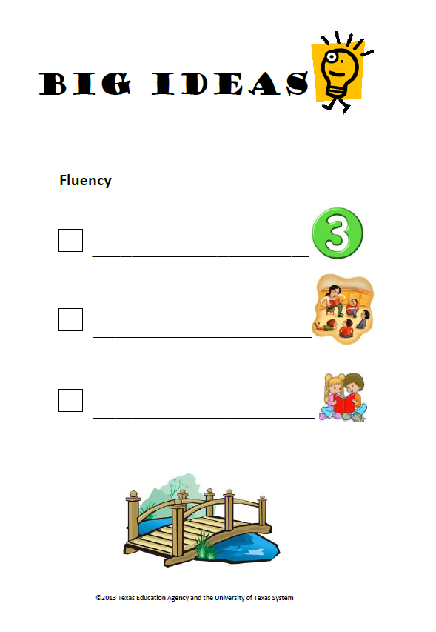
Big Ideas
Fluency= Accuracy, Rate, & Prosody
Model fluent reading
Opportunities for oral reading practice
Notes:
Say: Let’s look at our big Ideas card first. We will use this card today to help us track the important information we should take away from this session.
Click for first bullet to appear.
Say: On the first line, I would like you to write, “Fluency = Accuracy, rate and prosody.”
Say: We will learn today that there are three key components to fluency.
Click for second bullet to appear.
Say: On the second line, I would like you to write, “Model fluent reading.”
Say: As with all good teaching, we want to model for students what we expect them to do.
Click for third bullet to appear.
Say: On the next line, I would like you to write, “Opportunities for oral reading practice.”
Say: In order for students to improve their oral reading fluency, we need to provide multiple opportunities for them to practice. Today we will discuss some proven methods for helping students to improve their fluency. You’ll notice on the bottom of your Bid Ideas card there is a picture of a bridge. Let’s think about how a bridge relates to fluency.

Slide 3
The Fluency Bridge
“It may be helpful to think of reading fluency as a bridge between the two major components of reading – word decoding and comprehension. At one end of this bridge, fluency connects to accuracy and automaticity in decoding. At the other end, fluency connects to comprehension through prosody, or expressive interpretations.”
~ Rasinski, 2004
Notes:
Say:
In Assessing Reading Fluency (2004) , Dr. Timothy Rasinski says …
DO:
Read slide.
Say:
Fluency is the skill that allows students who can decode written text to be able to make sense of the text. However, how many of you know or have had experience with students who can read text accurately and at a reasonable pace, but they don’t seem to be able to comprehend what they read? We’re going to look at what may be the cause of this problem, and learn and practice strategies which can enable students to develop the kind of fluency necessary for comprehension.

Slide 4
Training Goals
Understand the meaning of “fluency”
Practice determining levels of accuracy, rate, and prosody
Explore letter/sound fluency, high frequency word fluency, phrase fluency, and connected text fluency
Learn and practice strategies teachers can use to help build oral reading fluency
Notes:
Say: The goals of today’s training include: (read slide).

Slide 5
What is Fluency?
Notes:
Say: Today, we’ll be looking at fluency—what it is and what it is not, how it is measured, components of fluency, and how teachers can provide instruction that effectively supports the development of fluency across grade levels.
Let’s begin with a look at what research says about fluency.

Slide 6
Related Research
“Fluency is an essential element of reading for K-3 students. It is not something that only 2nd and 3rd grade teachers need to be concerned about. Fluency develops over time and from the beginning stages of reading.”
(Vaughn & Linan-Thompson, 2004, p. 50)
Notes:
Say: Researchers Sharon Vaughn and Sylvia Linan-Thompson explain that fluency is an “essential element of reading for K-3 students. It is not something that only 2nd and 3rd grade teachers need to be concerned about. Fluency develops over time and from the beginning stages of reading” (p. 50).
Fluency is one of the five essential components of reading, as determined by the National Reading Panel Report (2000). According to the Report, “It is generally acknowledged that fluency is a critical component of skilled reading. Nevertheless, it is often neglected in classroom instruction” (NRP, 2000, p. 3-1).

Slide 7
A Definition
fluency n. 1. the clear, easy, written or spoken expression of ideas. 2. freedom from word-identification problems that might hinder comprehension in silent reading or the expression of ideas in oral reading; automaticity.
(Harris & Hodges, 1995, p. 85)
Notes:
Say: Research tells us that fluency is a critical component of reading. So what exactly is fluency? The Literacy Dictionary (1995) defines fluency as “freedom from word-identification problems that might hinder comprehension in silent reading or the expression of ideas in oral reading; automaticity” (p. 85).

Slide 8
Related Research
“Reading fluency refers to the ability of readers to read quickly, effortlessly, and efficiently with good, meaningful expression….”
“Fluent readers... are able to read words accurately and effortlessly. They recognize words and phrases instantly on sight. Very little cognitive energy is expended in decoding the words. This means, then, that the maximum amount of cognitive energy can be directed to the all-important task of making sense of the text.”
(Rasinski, 2003, p. 26)
Notes:
Say: In his book, The Fluent Reader (2003), Dr. Timothy Rasinski explains that fluency refers to “the ability of readers to read quickly, effortlessly, and efficiently with good, meaningful expression” (p. 26). He goes on to explain that a fluent reader requires very little cognitive energy to decode words; therefore, most of the reader’s attention can be given to comprehending what is read.
Obviously, then, fluency is something that is not easily and simply defined. It involves decoding words effortlessly; recognizing irregular and high-frequency words automatically; yet it is more than word-reading accuracy. Fluency involves reading at an appropriate rate—neither too quickly nor too slowly. It involves paying attention not only to punctuation marks, but determining suitable interpretation of the passage through inflection, intonation, and voice to effectively communicate the meaning of the words on the page.

Slide 9
Fluency Is…
reading
letters,
words,
sentences, or
passages
with
accuracy,
automaticity,
and
prosody.
Notes:
Say: Fluency is more than the sum of its parts. However, it is generally accepted that fluency has three primary components: accuracy, automaticity (or rate), and prosody. Fluency includes reading individual letter names, isolated words, and connected text such as sentences and passages. Children at all levels should move into reading connected text as soon as possible. When students are able to read text successfully on their own, it allows them to develop more advanced word reading skills as well as increase fluency.
Let’s look in-depth at the three components of fluency and how we assess them: accuracy, automaticity, and prosody.

Slide 10
Accuracy
Accuracy refers to:
the ability of a reader to decode and/or recognize irregular and high-frequency words in text without error.
the percentage of words a reader reads correctly.
Notes:
Say: Accuracy refers to the ability of a reader to read or decode text accurately. To determine a student’s level of accuracy within a certain text, the student reads a passage aloud, and the teacher records the number of errors made by the student.
So, what is considered an error?

Slide 11
Determining Word Reading Accuracy
Count as errors
Do not count as errors
Omissions
Substitutions
Hesitations (more than three seconds)
Mispronunciations (such as leaving off or adding –s, -ed, and –ing)
Reversals
Self-corrections (within three seconds)
Insertions
Repetitions
Notes:
Say: Here is a list of some of the commonly cited errors and non-errors used when assessing student reading for word reading accuracy.
Errors may include:
Omissions: leaving out a word or words.
Substitutions: saying another word in place of the word in the text.
Hesitations: stopping or hesitating for more than three seconds, at which point the teacher provides the word. This is only counted as an error if the teacher provides the word (which s/he should do after 3-4 seconds when doing a fluency assessment).
Mispronunciations: leaving off or adding endings, or mispronouncing the word in a way that no longer makes sense. Do not count mispronunciations of proper nouns. Note: If a child has a speech issue in which he regularly replaces one sound (i.e., /f/) for another (i.e., /th/), it should not be counted as an error.
Reversals: changing the order of two or more words in a sentence.
Non-errors may include:
Self-corrections: realizing and correcting an error within three seconds.
Insertions: adding an extra word which is not in print.
Repetitions: repeating a word or phrase already read correctly.
Insertions and repetitions are not counted as errors because, if a timed fluency check is being done, the extra seconds used for insertions or repetitions are already considered in the calculations.

Slide 12
Determining Word Reading Accuracy
# of
words
read
# of
words
read
correctly
–
# of
errors
=
# of
words
read
correctly
# of
words
read
%
accurate
/
=
Notes:
Say: To determine a student’s word reading accuracy, the teacher and student sit down together, each with a copy of the text. Using a text containing word counts at the end of each line is particularly helpful for the teacher. The teacher listens as the student reads a passage of text, marking any errors on the copy of the text. When the student completes the reading, the teacher counts the total number of words read by the student (click), then subtracts the number of errors made by the student (click). This results in the number of words which the student read correctly (click). By taking the number of words read correctly (click) and dividing it by the total number of words in the passage (click), the teacher can determine the percentage of words which the student read correctly, known as the student’s rate of accuracy (click).

Slide 13
Levels of Performance for
Word Reading Accuracy
Level of Performance | Accuracy
Independent Level | 95-100%
Instructional Level | 90-94%
Frustrational Level | <90%
Notes:
Say: Once we determine a student’s accuracy rate (like we calculated on the last slide), we can then use this chart to determine the level of performance at which that student falls for that particular text. Readers who score in the 95-100% range - the independent level - are able to read that text, or a text of similar difficulty, without assistance. Those who score in the 90-94% range - the instructional level - can read that text, or a text of similar difficulty, with support. Readers who score below 90% are performing at the frustrational level, and will find that text and other similar texts too challenging to read, even with assistance (TPRI, 2010).
Knowing a student’s rate of accuracy can help teachers place students in appropriately-leveled text.

Slide 14
Automaticity and Rate
Automaticity is the “fluent processing of information that requires little effort or attention, as sight-word recognition.”
Rate is “how fast a person reads... ; reading speed.”
(Harris & Hodges, 2004, p. 16)
(Harris & Hodges, 2004, p. 202)
Notes:
Say: First, let’s look at some meanings for the terms “automaticity” and “rate”. The Literacy Dictionary defines them this way: (read slide).

Slide 15
Related Research
Perfetti (1977, 1985) suggests that slow word reading interferes with automaticity, and thus impairs reading comprehension.
Torgeson, Wagner, & Rashotte (1994) indicate that many students who have reading difficulties have significant problems with fluency and continue to be slow readers into adolescence and adulthood.
Notes:
Say: Simply being an accurate reader may not guarantee that a child is a proficient reader—one who also reads with comprehension. Automaticity - an important component of fluency - is the rate at which a reader reads a passage. When a student reads too slowly, it may interfere with his ability to comprehend the text. The student applies so much effort to decoding regular words and recalling high-frequency words that he does not have the cognitive energy to devote to comprehending the material read. Alternatively, there are students who put so much emphasis on quickly decoding a passage that reading becomes a kind of race to them. As a result, they lose focus on comprehension of the text.
Students who struggle with fluency often continue to be struggling readers into adulthood, unless attention and intervention is provided to adjust their fluency rate.

Slide 16
Determining
Automaticity / Rate
# of
words
read in
one minute
# of words
read correctly
in one minute
(wcpm)
# of
errors
–
=
100
–
5
=
95 wcpm
Notes:
Say: To calculate rate, the teacher and student sit together, each with a copy of the text. The teacher has a stopwatch. On the teacher’s signal, the student begins reading the passage. The teacher listens and follows along in the text, marking errors that the student makes (as we did when calculating accuracy). When the student has read for one minute, the teacher signals the student to stop reading, and the teacher marks the last word read by the student within the minute. The teacher can now determine how many words were read in one minute. (Click.) The teacher then counts the number of errors made by the student, and subtracts that number from the total number of words read (click). The resulting number (click) is the wcpm, or words correct per minute, read by the student.
When conducting this evaluation, it is important to remind students to read at a normal rate. Remember, fluency is not about reading fast—it is about reading with accuracy, automaticity, prosody, and comprehension.

Slide 17
2006 Hasbrouck & Tindal
Oral Reading Fluency Data
Grade | Percentile | Fall WCPM | Winter WCPM | Spring WCPM
1 | 90 75 50 25 |  | 81 47 23 12 | 111 82 53 28
2 | 90 75 50 25 | 106 79 51 25 | 125 100 72 42 | 142 117 89 61
3 | 90 75 50 25 | 128 99 71 44 | 146 120 92 62 | 162 137 107 78
(www.readnaturally.com)
Notes:
Say: Researchers Hasbrouck and Tindal (2006) did an extensive study of oral reading fluency. This table indicates the average oral reading fluency of students in grades 1 through 3 as determined by their study. In other words, a child reading 53 words correct per minute in the spring of their first grade year is at the 50th percentile in oral reading fluency on the passage read. A third-grader reading 107 wcpm at the end of third grade is also at the 50th percentile; to be at the 90th percentile, a third-grader needs to read approximately 162 wcpm by the end of the year on a grade-level appropriate passage.
So… if a first-grade student is reading 60 wcpm at the end of the year, at approximately what percentile is he? Turn and discuss with your partner.
(Allow participants a moment to discuss and determine the correct answer.)
Say: If a third-grade student reads 89 wcpm at the middle of the year, at approximately what percentile is she? Again, turn and discuss with your partner.
(Allow participants a moment to discuss and determine the correct answer.)
Note to presenter: In both of these examples, the answer should be somewhere around the 50th percentile.

Slide 18
Prosody
Prosody is “the pitch, loudness, tempo, and rhythm patterns of spoken language.”
(Harris & Hodges, 2004, p. 196)
Notes:
Say: The third component of fluency is prosody. According to The Literacy Dictionary, (read slide).

Slide 19
Related Research
“If readers read quickly and accurately but with no expression in their voices, if they place equal emphasis on every word and have no sense of phrasing, and if they ignore most punctuation… then it is unlikely that they will fully understand the text.”
(Rasinski, 2004, p. 46)
Notes:
Say: According to Rasinski (2004), prosody also has a direct link to comprehension. (Read slide.)
Prosody involves reading with intonation, expressive interpretation, attention to punctuation—to put it simply, it means reading the way a person speaks. A child who reads robotically - sounding out words in a monotone voice, putting equal emphasis on each word, ignoring punctuation - is unlikely to be able to comprehend what he has read.

Slide 20
Adapted Version of NAEP’s
Oral Reading Fluency Scale
HO 3
 | Level 4 | Reads primarily in larger, meaningful phrase groups. Although some regressions, repetitions, and deviations from text may be present, these do not appear to detract from the overall structure of the story. Preservation of the author’s syntax is consistent. Some or most of the story is read with expressive interpretation.
 | Level 3 | Reads primarily in three- or four-word phrase groups. Some small groupings may be present. However, the majority of phrasing seems appropriate and preserves the syntax of the author. Little or no expressive interpretation is present.
 | Level 2 | Reads primarily in two-word phrases with some three- or four-word groupings. Some word-by-word reading may be present. Word groupings may seem awkward and unrelated to larger context of sentence or passage.
 | Level 1 | Reads primarily word-by-word. Occasional two-word or three-word phrases may occur—but these are infrequent and/or they do not preserve meaningful syntax.
Fluent
Nonfluent
(NAEP, 2002)
Notes:
Say: The 2002 Oral Reading Study done by the National Assessment of Educational Progress (NAEP) developed an Oral Reading Fluency Scale to help teachers assess students’ reading prosody.
Look at Handout #3 with your partner. Select one person to read the descriptors for Level 1 and 2, and the other will read the descriptors for Level 3 and 4. After reading each descriptor, discuss what the different levels of prosody might look like and sound like in the classroom.
(Give participants time to discuss. Time permitting, allow participants to share answers with the whole group.)

Slide 21
Types of Fluency
Notes:
Say: When we talk about fluency, we normally think of connected text fluency. However, there are additional types of fluency that we will examine today.

Slide 22
Related Research
“If children do not acquire good word reading skills early in elementary school, they will be cut off from the rich knowledge sources available in print, and this may be particularly unfortunate for children who are already weak in general verbal knowledge and ability.”
(Torgesen, 2000, p. 28)
Notes:
Read quote.
Say: Students of all grade levels can and should practice oral reading. The next few slides will discuss ways students can work on developing fluency even before they are able to read connected text.

Slide 23
Types of Fluency
Letter naming/letter sound fluency
High-frequency word fluency
High-frequency phrase fluency
Connected text fluency
Notes:
Say: The ultimate goal for a student is to be able to read grade-level text with accuracy, automaticity, prosody, and comprehension. However, in order to develop connected text fluency, there are other types of fluency which are foundational. These include letter naming/letter sound fluency, high-frequency word fluency, and high-frequency phrase fluency. We are going to look at some specific activities teachers can use to build these skills.

Slide 24
Related Research
“Just measuring how many letters a kindergartner is able to name when shown letters in a random order appears to be nearly as successful at predicting future reading, as is an entire readiness test.”
(National Reading Council, 1998, p. 113)
Notes:
Say: In the National Research Council’s book, Preventing Reading Difficulties in Young Children, predictors of early reading are discussed. The surprising findings showed that (read quote on slide).
Louisa Moats (2009) reiterates the importance of letter naming fluency when she states, “The orthographic processing system stores information about print that is necessary for word recognition and spelling. The speed with which letters are recognized and recalled is very important for proficient reading. Obviously, print images must be associated with meaning for reading comprehension to occur. Children with orthographic processing weaknesses will have trouble forming ‘sight word’ habits, will be poor spellers, and will often read slowly because they are sounding everything out long after they should be doing that” (p. 35).

Slide 25
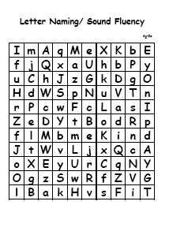
Letter Naming Fluency
HO 4
Students need to be able to fluently name the letters of the alphabet, capital and lowercase, in order and out of order.
“Fluently” refers primarily to being able to name each letter correctly, taking no more than three seconds per letter.
Notes:
Say: By the beginning of first grade, students should be able to fluently name each letter of the alphabet, both capital and lowercase, in order and out of order. Students should take no more than three seconds to name any letter.
Charts such as the ones in Handout 3 can help give daily practice to naming letters. Also, the Florida Center for Reading Research website contains several activities appropriate for early elementary grades for letter naming fluency. The website address can be found in the references for this presentation.

Slide 26
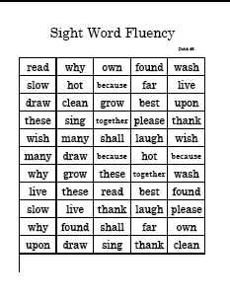
High-Frequency Word Fluency
HO 4
“Recent studies on reading indicate that a limited amount of word-reading practice, whether in the form of flash cards, word banks, or word walls can have a beneficial effect on students’ word-recognition skills.”
(Rasinski, 2003, p. 94)
Notes:
Say: Recent studies on reading indicate that a limited amount of word-reading practice, whether in the form of flash cards (Nicholson, 1998; Tan & Nicholson, 1997), word banks (Bear, 1996), or word walls (Cunningham, 1995) can have a beneficial effect on students’ word-recognition skills. In these activities, students read isolated words repeated times so that they become able to recognize them quickly and accurately.
Fry (as cited in Rasinski, 2003, p. 94) developed a list of 300 words which he says make up two-thirds of all the words students will encounter in their elementary school reading. The FCRR website also lists about 300 high-frequency words students should know by the end of grade 3. These words, and corresponding activities to reinforce the learning of the words, are available for download at www.fcrr.org.

Slide 27
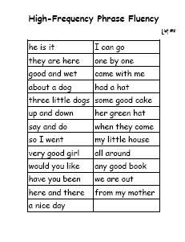
High-Frequency Word Fluency
HO 4
“…along with a limited amount of practice of high-frequency words in isolation, students (should) do repeated reading of these words in the context of short sentences and phrases.”
(Rasinski, 2003, p. 94)
Notes:
Say: Learning words in isolation can be beneficial, but teachers should be cautious that students do not come to believe that reading is only about word identification. Practicing only isolated words could lead to word-by-word reading, which may interfere with fluency. Therefore, Rasinski (2003) and others recommend that students should also repeatedly read high-frequency words embedded in short sentences and phrases. We’ll refer to this as “high-frequency phrase fluency”. According to Rasinski (2003), “Repeated reading of a few phrases per week not only gives students the practice they need to learn high-frequency words, but also gives them practice in reading phrases, which is key to developing fluency and general proficiency.”

Slide 28

Connected Text Fluency
“When we become fluent at a task, we can devote our attention to other related tasks….Through practice, the reader’s decoding can become so fluent that she pays maximum attention to creating meaning from the words she encounters.”
(Rasinski, 2003, p. 77)
Notes:
Read quote.
Say: Repeated reading of connected text, including stories and books, at a student’s independent or instructional level can increase the student’s level of fluency, including her accuracy, her rate, and her prosody. In turn, fluency will promote comprehension, since the student is free to use cognitive energy to comprehend text, rather than spending all of her energy decoding.

Slide 29
How Can a Teacher Help Students Build Fluency?
Notes:
Say: We’re going to look at some strategies teachers can use to help build reading fluency, particularly connected text fluency.

Slide 30
Small Group Reading Example
“Oral reading plays a significant role in effective reading instruction. It is an important tool in any teacher’s kit of instructional strategies. In the earliest grades, oral reading may take on a primary role instruction.
Oral reading can make reading instruction more varied, more interesting and more powerful. The key is knowing how to use oral reading to its full potential.”
(Rasinski, 2003, p. 36.)
Notes:
Do: Identify a small group of participants to take turns reading the information on the slide one sentence at a time.
Say: Does anyone know what this type of approach to reading is called? (Round Robin Reading)

Slide 31
Related Research
“Despite its widespread use, round-robin reading has never been widely advocated nor endorsed by scholars of reading.”
(Rasinski, 2003, p. 20)
“It is evident that with round-robin procedures students receive little actual practice in reading because no child is allowed to read for very long.”
(National Reading Panel, 2000, p. 3-11)
Notes:
Read quotes.

Slide 32
Ways to Build Reading Fluency
Effectively model fluent reading
Provide oral support of student reading through structured oral reading practice
Offer multiple opportunities for practice
Encourage fluency through phrasing
(Rasinski, 2003)
Notes:
Say: There are a number of more effective strategies teachers can use to help build oral reading fluency in students. Today, we are going to examine four: modeling fluent reading, providing support and scaffolds, ensuring multiple opportunities for practice, and phrasing.

Slide 33
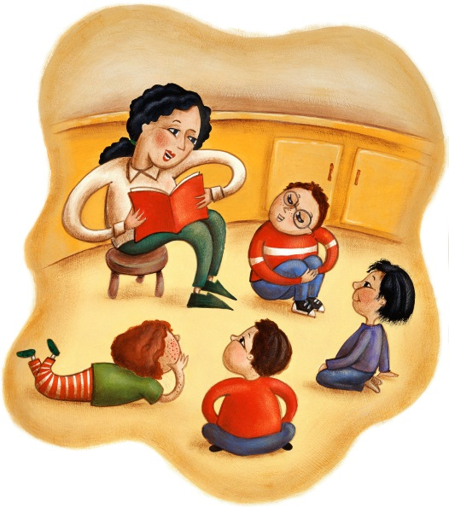
Effectively Model Fluent Reading
Read with expression and enthusiasm
Draw attention to how the passage is read
Demonstrate examples and non-examples
Notes:
Say: One of the most enjoyable and effective ways of promoting fluency is to effectively model fluent reading. This can be done during the reading block, using literature from the student anthology; during math, science, social studies and other core subject areas, using both literary and informational texts related to the day’s objectives. Students of all ages enjoy listening to books being read aloud, provided the reader uses appropriate pace and prosody.
In order to model fluent reading, the teacher needs to read with expression and enthusiasm! Draw the students into the story through the use of inflection, voice, and even emotion. As you read to the students, you may want to do some “thinking aloud” where you stop and reflect on how the character in the story might sound, and how you might imitate his voice.

Slide 34

Fluency: Non-Examples
Robot Reading: Students read without expression
Race Car Reading: Students attempt to read as quickly as possible
Stop-and-Go Reading: Students stop when they come to a word they don’t know and wait for someone to tell them the word
Slow-and-Steady Reading: Students read at a slow, steady rate for the entire passage
Notes:
Say: Some non-examples of fluency commonly heard and seen in classrooms are represented here. Robot Reading is reading in a monotone, flat voice void of expression. Race Car Reading usually springs from a misunderstanding of the true meaning of fluency. Students attempt to read as quickly as possible, without paying attention to prosody or comprehension. Stop-and-Go Reading often reflects a student’s inability to decode words accurately, especially multisyllabic words and sometimes high-frequency words as well. Students pause at a word they are not able to easily read, waiting for someone to give them the word, rather than using strategies to attempt to decode it. Slow-and-Steady Reading is characterized by a lack of appropriate pace and/or prosody.
As they model fluent reading, teachers may also want to explicitly model non-examples of fluent reading. By explicitly explaining that these are non-examples, and comparing and contrasting them with examples of fluent reading, the teacher can help students gain a better understanding of what is expected of a fluent reader.

Slide 35
Effectively Model Fluent Reading
“Every time we read to a child, we’re sending a ‘pleasure’ message to the child’s brain. You could even call it a commercial, conditioning the child to associate books and print with pleasure.”
Remember, students of ALL ages
love being read to!
(Trelease ,1995, as cited in Rasinski, 2003, p. 39)
Notes:
Read slide.

Slide 36
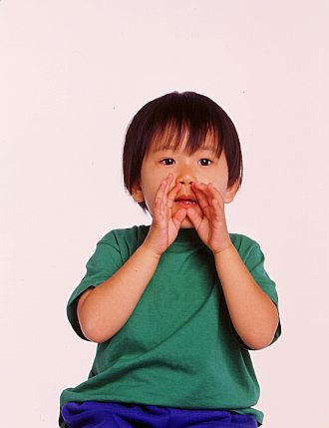

Structured Oral Reading Practice
Echo reading
Choral reading
Paired reading
Notes:
Say: In addition to effectively modeling fluent reading, a teacher can also build student fluency by providing support of student oral reading. Three of the ways teachers can accomplish this are through echo reading, choral reading, and paired reading.

Slide 37
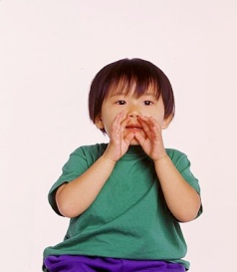
Echo Reading
Teacher reads one sentence at a time - modeling appropriate phrasing, intonation, and expression - as students listen.
When teacher gives students a signal to begin, students read the same phrase chorally.
Teacher provides corrective feedback.
This technique is highly supportive.
Notes:
Say: The first type of oral reading we’re going to discuss is echo reading. It provides a high level of teacher support, so it can be used with stories that are more difficult for students.
Read slide.
Using the same passage as the round-robin exercise, practice echo reading. Have a volunteer time how long the students are reading.

Slide 38
Choral Reading
When teacher gives students a signal to begin, students and teacher read a passage together orally.
Teacher begins reading with a strong voice, then gradually reads more softly.
Teacher gives corrective feedback as necessary.
This technique is less supportive than echo reading.
Notes:
Say: The second type of reading we’ll be discussing is choral reading. It’s less supportive than echo reading, so we might use it on a story that is on many students’ instructional level, or when we’re reading a challenging story for the second or third time.
Read slide.
As students begin to read with more confidence, the teacher should decrease the volume of her voice so that students rely less on her model. The teacher’s voice becomes a quiet “safety net.” She can increase the volume of her voice during more challenging parts of the text.
Using the same passage as the round-robin exercise, practice choral reading. Have a volunteer time how long the students are reading.

Slide 39

Paired Reading
Teacher strategically assigns reading partners.
Text must be at an independent or instructional level for BOTH students.
Students take turns reading the text.
Teacher monitors & gives corrective feedback.
Less supportive than echo or choral reading.
The procedure must be modeled and practiced.
Notes:
Say: The last type of reading we will discuss is paired, or “buddy” reading. It’s the least supportive of the types we’ve discussed, so it should be used when a passage is on students’ independent or instructional level.
Read slide.
Say: The teacher needs to make certain the students are paired strategically rather than randomly. A common effective practice is to pair a strong reader with an average reader, or an average reader with a struggling reader. This way, one partner can better assist the other as they are reading. If there is an odd number of students to be paired, a triad may be formed. During paired reading, it is recommended that the teacher NOT be a reading partner, so that he is able to monitor and observe all of the readers. Be sure that the text is on a level that is either independent or instructional for BOTH readers.

Slide 40
Echo reading
Choral reading
Paired reading
Notes:
Say: Remember that each of these three methods for giving students oral reading time can be used across content areas, and at any grade level.

Slide 41
Multiple Opportunities for Practice
Repeated readings
  Echo reading
  Choral reading
  Paired reading
Whisper reading
Readers’ Theater
Reading familiar song lyrics
Radio Reading
Poetry Club
Mentor/Big Buddy Reading
Notes:
Say: Providing multiple opportunities for practice in reading connected text can be done using any of the aforementioned strategies, including echo reading, choral reading, and paired reading. Other practices include whisper reading, Readers’ Theater, reading familiar song lyrics, Radio Reading, Poetry Club, and Mentor/Big Buddy Reading, to name a few.

Slide 42


Fluency Through Phrasing –
Attention to Punctuation
A B C D.
E F G?
H I J K L, M N.
O, P Q R!
T?
U V W X.
Y, Z!
Notes:
Say: Even before students are able to read connected text, it is possible to begin teaching them to pay attention to punctuation. One simple and fun activity is to use letters of the alphabet to create “sentences” with punctuation. Read the letters on this slide with me, paying attention to the punctuation and using appropriate inflection.
Ready? Let’s begin. A B C... (Read slide.)

Slide 43
Fluency Through Phrasing –Phrase-Cued Text
“One of the chief characteristics / of the disfluent reader / is staccato,/ word-by-word / oral reading.// Decoding tends to be so difficult for these readers / that they stumble / over nearly every word.// They do not easily grasp / the meaning of phrases / because they don’t process text / in phrasal units.//”
(Rasinski, 2003, p. 140)
Notes:
Say: Phrase-cueing text by marking phrase boundaries gives students added support in reading prosodically. Single slashes can be used to indicate boundaries within a sentence, usually short pauses, and double slashes can be used for boundaries at the end of a sentence, indicating a longer pause.
I have phrase-cued a quote. Listen as I read it. Pay attention to the pauses I make. (Read slide.)
Now, let’s read the slide together chorally, paying attention to the slashes. (Read slide chorally.)
What kind of students might benefit from phrase-cued text? When might you use phrase-cued text in your classroom? Think... then turn and talk with your partner.

Slide 44
What Kind of Feedback Should I Give to a Student Who Is Lacking Fluency?
Notes:
Say: Corrective feedback is an essential part of oral reading fluency practice. Let’s look at a poem with which we are all familiar - Mary Had a Little Lamb - and see what kind of feedback should be given to students having difficulty with accuracy, prosody, or rate.

Slide 45

Providing Feedback For Accuracy
Mary had a little lam - b,
Its fleas was white as snow.
And everyone that Mary went
The lam-b was sorry to go.
Notes:
Say: Let’s imagine that one or more of your students are still struggling with decoding some of the words in the stanza. (Read slide.)
What are some ways you could provide corrective feedback for a student struggling with accuracy?

Slide 46

Providing Feedback For Accuracy
Student: “Mary had a little lam-b”
Teacher: Look at that word again. What do you notice about the end of that word? What sound do the letters mb make when they are together?
Student: “Its fleas was white as snow”
Teacher: There’s a ce at the end of that word. What sound does ce make? Read the word again.
Notes:
Say: To begin, you could refer to specific spelling patterns and letter/sound associations which have been taught in order to help the student logically and accurately sound out the word.
(Read slide.)

Slide 47

Providing Feedback For Accuracy
“And everyone that Mary went”
Does that make sense?
Look at all the letters. That’s a compound word. Read the first word. Read the second word. Now, put them together.
“The lamb was sorry to go”
That word is “sure.” What is the word?
Notes:
Say: For compound words and other multisyllabic words, you could help the student identify the syllables and word parts in order to break them down and sound them out accurately.
For irregular or high-frequency words, the best approach may be to simply say the word for the student and have them repeat it back to you one or more times.
(Read slide.)

Slide 48
Providing Feedback For Prosody
Student:
“Mary had a little. Lamb, its fleece was.
White. As snow and, everywhere.
That Mary!
Went, the lamb was sure.
To go?”
Teacher:
Did that make sense? Listen as I model reading the poem for you. Then let’s echo-read the poem. I’ll read a line, then you read it just the way I read it.
Notes:
Say: Here’s another example. This student is having some issues with prosody.
(Read stanza, pausing as punctuated.)
Say: In this case you might ask the student if the poem made sense to them as they read it. Then, model reading the poem correctly. Finally, as you read each line of the poem correctly, with the proper phrasing and intonation, have the student echo-read it back to you.

Slide 49
Providing Feedback For Automaticity/Rate
Student:
“Maryhadalittlelambitsfleecewaswhiteassnowand
everywherethatMarywentthelambwassuretogo…”
Teacher:
Does that sound like talking?
How do you think Mary might read that poem?
You read that so fast, I couldn’t understand it. Could you read it again more slowly?
Let me model that phrase for you...
Notes:
Say: Finally, this student is having difficulty with prosody.
(Read stanza, making no breaks and reading quickly.)
Say: Here, you might ask the student if she read the poem in the same manner she usually talks. Explain that good readers read using about the same rate they use when speaking. You may want to ask the student to pretend that she is Mary, and read it the way Mary would read it - as if telling a story. Or, you could simply tell the student that she was reading so quickly, she was difficult to understand. You could ask the student to read the poem again, but more slowly, so you can catch all the words and understand what it means. Finally, modeling fluent reading or echo-reading with the student can help her understand what it means to read fluently, with the appropriate rate.

Slide 50

What’s Important To Remember About Fluency Instruction?
Think
Turn
Talk
Notes:
Say: Think for a moment - what’s important to remember about fluency instruction? Of the things we have discussed, what will you take back and practice in your classroom? (Pause for 8 seconds.)
Turn and talk with your partner about key insights from today’s look at fluency.

Slide 51
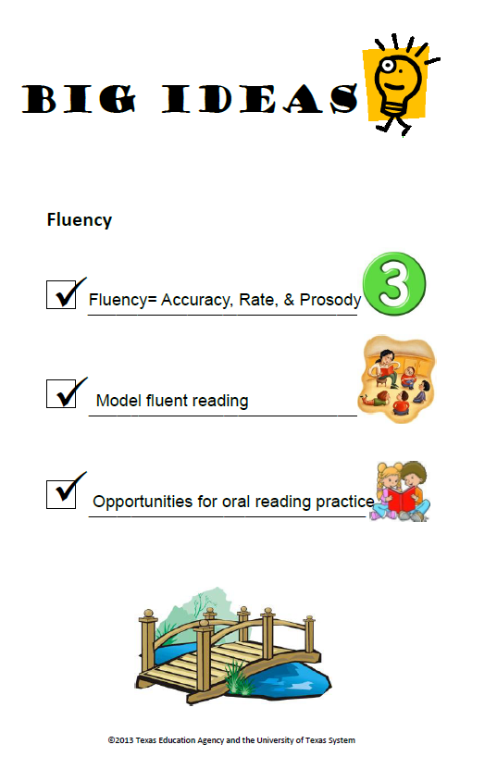
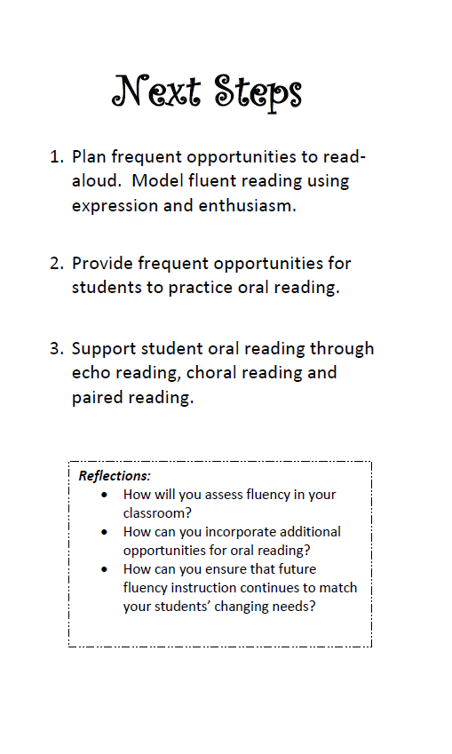
Big Ideas
Notes:
Say: Let’s revisit the “big ideas” for this session.
First, we found out that there are three key components to fluency. Accuracy, reading words correctly, rate, reading at an appropriate speed, and prosody, reading with expression and intonation.
We help our students become fluent readers by modeling for them what fluent reading sounds like and we provide multiple opportunities for our students to practice reading fluently.
As you leave this session today, we want to think about our next steps. We want to take what we have learned here and apply it in our classrooms so that we can truly impact student learning and achievement. Read the 3 steps on the back of this card. Write down at the bottom what your commitment will be for teaching this strategy when you return to school.

Slide 52

By equipping our students with not only the ability to read, but the ability to read fluently - with accuracy, prosody, and automaticity - we can enable our students to discover the pleasure and joy of reading, and it can become not only something to be done during the school years, but throughout all of life.
Notes:
Read slide.

Slide 53
References
Bear, D. R., Invernizzi, M., Templeton, S., & Johnston, F. (2004). Words their way: Word study for phonics, vocabulary, and spelling instruction. Upper Saddle River, NJ: Pearson Education, Inc.
Cunningham, P. M., Hall, D. P., & Sigmon, C. (1999). The teacher’s guide to the four blocks. Greensboro, NC: Carson Dellosa.
Daane, M., Campbell, J., Grigg, W., Goodman, M., & Oranje, A. (2002). Fourth-grade students reading aloud: NAEP 2002 special study of oral reading. U.S. Department of Education, Institute of Education Sciences, National Center for Education Statistics, National Assessment of Educational Progress.
dePaola, T. (1983). The legend of the bluebonnet. New York, NY: Scholastic Inc.
Harris, T. L., & Hodges, R. E. (Eds.). (2005). The literacy dictionary. Newark, Delaware: International Reading Association.
Hasbrouck & Tindal Oral Reading Fluency Data Chart 2006. Retrieved on March 12, 2009, from www.readnaturally.com/pdf/oralreadingfluency.pdf.
Honig, B., Diamond, L., & Gutlohn, L., (2000). Teaching reading sourcebook for kindergarten through eighth grade. Novato, CA: Arena Press.

Slide 54
References
Moats, L., & Tolman, C. (2009). The challenge of learning to read (2nd ed.). Boston: Sopris West.
National Reading Panel. (2000). Report of the National Reading Panel: Teaching children to read. Report of the subgroups. Washington, D.C.: U.S. Department of Health and Human Services, National Institutes of Health.
Nicholson, T. (1998). The flashcard strikes back. The Reading Teacher, 52(2), 188-192.
Opitz, M. F., & Rasinski, T. V. (1998). Good-bye round robin: 25 effective oral reading strategies. Portsmouth, NH: Heinemann.
Perfetti, C.A. (1977). Language comprehension and fast decoding: Some psycholinguistic prerequisites for skilled reading comprehension. In J. Guthrie (Ed.), Cognition, curriculum and comprehension. Newark, DE: International Reading Association.
Perfetti, C.A. (1985). Some reasons to save the grapheme and the phoneme. Commentary in
Brain and Behavior Sciences, 8(4).
Rasinski, T. V. (2004). Assessing reading fluency. Honolulu, HI: Pacific Resources for Education and Learning.
Rasinski, T. V. (2007). Creating fluent readers. Peterborough, NH: Staff Development for Educators.

Slide 55
References
Rasinski, T. V. (2003). The fluent reader: Oral reading strategies for building word recognition, fluency, and comprehension. New York: Scholastic Professional Books.
Snow, C. E., Burns, M. S., & Griffin, P. (1998). Preventing reading difficulties in young children. Washington, DC: National Academy Press.
Tan, A., & Nicholson, T. (1997). Flashcards revisited: Training poor readers to read words faster improves their comprehension of text. Journal of Educational Psychology, 89(2), 276-288.
Torgesen, J. K., Wagner, R. K., & Rashotte, C. A. (1994). Longitudinal studies of phonological processing and reading. Journal of Learning Disabilities, 27(5), 276-286.
Trelease, J. (2006). The read-aloud handbook. New York, NY: The Penguin Group.
Truss, Lynne. (2003). Eats, Shoots & Leaves. New York: The Penguin Group.
Vaughn, S., & Linan-Thompson, S. (2004). Research-Based Methods of Reading Instruction. Alexandria, VA: Association for Supervision and Curriculum Development.
Zutell, J., & Rasinski, T. (1991). Training teachers to attend to their students’ oral reading fluency. Theory into Practice, 30(3), 211-217.

