Slide 1
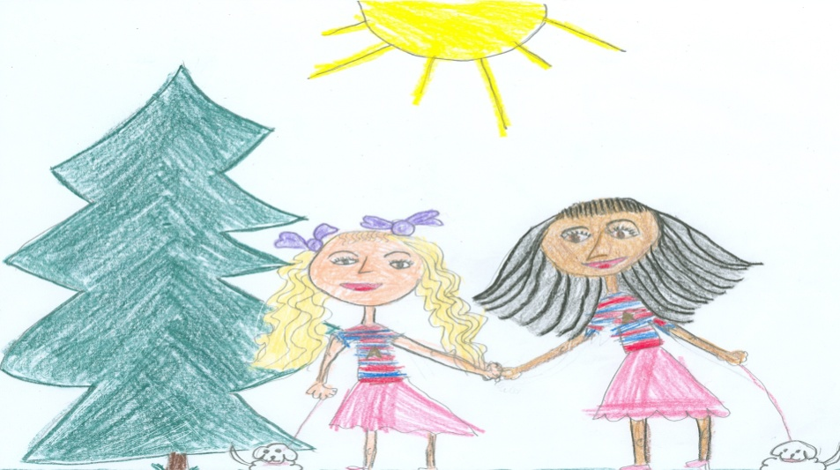

Making Connections
Grades 3-5
Notes:
Introduce self and welcome participants.
Let’s begin by reviewing the materials you need for this training.
(Hold items up as you talk.)
Say: You will have two sets of handouts. You will have a PowerPoint Presentation Handout and Additional Handouts. You will also need the blue and white Cognitive Strategy Routine card, the orange Cognitive Strategy Lesson Planning card, and the Big Ideas card for this session.
Let’s begin by filling out your Big Ideas card.

Slide 2
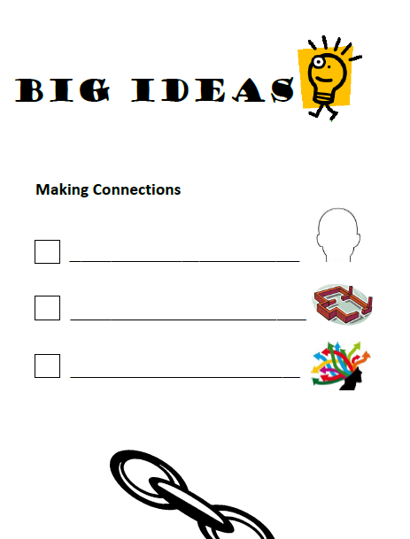
Big Ideas
Activate/build
background knowledge
Making Connections =
foundational strategy
Understand
distracting connections
Notes:
Say: We will use this card today to help us track the important information we should take away from this session. Let’s take a moment to consider the “Big Ideas” for Making Connections.
Good readers access their background knowledge when reading. As teachers, we can introduce text to students in a way that helps to activate readers’ background knowledge to aid comprehension. Sometimes however, our students may not have sufficient background knowledge about a subject. If this is the case, then we’ll need to help students to build background knowledge.
On the first line, write, “Activate/build background knowledge.”
Click for first bullet to appear.
Say: Good readers make connections between text and their background knowledge to help them understand and remember the text better. Readers also use this background knowledge to create mental images, to make inferences, to ask questions, etc. Making Connections is really a foundational strategy.
On the second line, write, “Making Connections = foundational strategy.”
Click for second bullet to appear.
Say: Good readers also understand when their connections actually distract them and take them away from understanding the text. We’ll talk about how to manage these distracting connections.
On the third line, write, “Understand distracting connections.”
Click for third bullet to appear.

Slide 3
Training Goals
Clarify the difference between activating and building background knowledge.
Understand the importance of Making Connections as a foundational strategy.
Plan and practice an introduction lesson for Making Connections.
Plan and practice a think-aloud lesson for teaching Making Connections
Notes:
Say: Let’s review our goals for today.
Read slide.

Slide 4
What does this store sell?
Blinds For Sale
Goose Hunting Season Opens Soon
(Adapted from Wilhelm, 2004)
Notes:
Say: Let’s begin our session today by thinking about how we use our background knowledge to make connections and how this impacts our understanding. If you saw this sign, what kind of store do you think it would be? Turn and tell your partner.
Allow a moment for participants to talk with a partner. Have one or two participants share.
Say: Does this change your understanding?
Click to reveal text: Goose Hunting Season Opens Soon.
Say: Now what type of store do you think this might be?
Allow a moment for conversation.
Say: When we first read the sign, we used our background knowledge and made one connection. What did you connect to?
Click to reveal picture of window blinds.
Say: You probably thought of this.
Click to reveal picture of camouflaged man.
Say: As we were provided with more information, however, we made another connection. We thought of another kind of blind – a place to camouflage while hunting. If you don’t have ANY background knowledge of a hunting blind, you might have become totally confused. Readers continually make connections to their background knowledge to help them understand text.

Slide 5
Why is Background Knowledge Important?
“The many active processes of reading –
prediction
construction of images during reading
monitoring of comprehension and rereading
summarization
interpretation
– depend greatly on prior knowledge.”
                (Pressley, 2000)
Notes:
Say: Our students must understand that what they already know is important. Therefore, we introduce them to the concept of background knowledge. Our background knowledge provides a basis for our use of most other cognitive strategies.
For example, when we create mental images, they are based on things we have seen and experienced – our background knowledge.
When we make inferences, we combine our background knowledge with information from the text. We use not only our background knowledge of “real-world” experiences, but our background knowledge of familiar text structures.
When something we read doesn’t fit in with our background knowledge, we ask questions to try to incorporate new learning into what we already know.
Therefore, Making Connections to background knowledge is often the first cognitive strategy we teach. As educational psychologist, Michael Pressley (2000) puts it:
Read slide.

Slide 6

“Our prior experience and background knowledge fuel the connections we make.
  the books we read
  the authors we choose
  the discussions we have
  our past experiences
  the newspaper
  the evening news
  the weekly magazines
  he Internet
  and nightly dinner table conversations …
  all forge connections that lead to new insight. We teach kids to think about their connections and read in ways that let them discover these threads.”
(Harvey and Goudvis, 2000)
Notes:
Say: In this quote, authors Stephanie Harvey and Anne Goudvis (2000) describes some of the ways we acquire background knowledge. Take a moment to read this slide and think about all the ways to build your background knowledge.

Slide 7


Knowledge of Baseball
Comprehension
Good Readers
Struggling Readers
(Recht & Leslie, 1988)
Comprehension
Notes:
Say: Let’s consider an example of how background knowledge makes a difference in comprehension:
Recht and Leslie (1988) conducted a study to research the effects of background knowledge on reading comprehension. They tested two groups of students – good readers and poor readers. They also tested the students’ knowledge of baseball.
Click to animate. There were good readers who had little knowledge of baseball.
Click to animate. There were good readers who knew a lot about baseball.
Click to animate. There were struggling readers who had little knowledge of baseball.
Click to animate. There were struggling readers who knew a lot about baseball.
Say: The students’ were then asked to read a passage about a baseball game and were tested on comprehension.
Click to animate. Struggling reader with baseball cap will rise to equal good readers.
Say: The researchers found that poor readers who knew more about baseball had comprehension almost equal to good readers who knew about baseball.
Click to animate. Good reader without baseball cap will sink to equal struggling reader. The good readers who didn’t know much about baseball struggled to comprehend the passage. Their comprehension wasn’t much higher than the struggling readers who didn’t know much about baseball.
In other words, we can better understand a text that’s about something familiar than we can a text that’s unfamiliar – even if we’re struggling readers.

Slide 8
All Students Have Background Knowledge
“…all students have background knowledge even though not all of them have the academic background knowledge necessary to do well in school. The background knowledge that is not germane to academic success may still be highly valuable in other contexts and, as such, should be honored along with the bearers of that knowledge.”
(Marzano, 2004)
Notes:
Say: Occasionally, we may hear a teacher say, “My students don’t have background knowledge.” ALL students, however, have background knowledge built on their life experiences. Some background knowledge is academic in nature and relates to things they will learn in school. A student who has been allowed to shop at the neighborhood store, for example, will have background knowledge for money and its uses. This knowledge will help the student during math lessons. A student who has never had such experiences may need to build the background knowledge from the ground up, and will find it more difficult.
Some background knowledge relates to non-academic concepts. For example, a student might have well-developed background knowledge about soccer. This may have some usefulness in school, but will be less-generally useful than background knowledge for using money.
We need to get to know our students well so that we can understand what they have developed background knowledge of. Once we have this knowledge, will need to do two things to make our comprehension instruction work: we will need to either build NEW background knowledge or activate EXISTING background knowledge.

Slide 9
Build? Or Activate?
Building Background Knowledge
Students know little or nothing about a topic
May take place 1-2 weeks before reading
Takes 3-4 exposures, no more than 2 days apart
Activating Background Knowledge
Students have some knowledge of a topic
Takes place directly prior to reading
Takes 2-10 minutes
Notes:
Say: What is the difference between building background knowledge and activating existing knowledge?
Click. Say: We build background knowledge when our students have little knowledge of the topic of a story.
Click. Say: When our students have some knowledge of a topic, and we simply want to help them remember, we activate background knowledge.
Click. Say: Building new background knowledge takes time. Therefore, we must plan ahead. We will begin one or two weeks before reading the selection.
Click. Say: Activating background knowledge can take place just a few moments before we read.
Click. Say: When building new background knowledge we must remember that a single exposure is not enough. It takes 3-4 exposures to new information, no more than two days apart.
Click. Say: Activating background knowledge should take only 2-10 minutes. We don’t want to tell our students everything that will be in the story – we must leave some problem-solving for them. Instead, we want to activate what is crucial to understanding.
Now we will look at each of these techniques separately.

Slide 10
Building Background Knowledge
When beginning a new unit or topic of study, assess what students do/do not know. (Wilhem, 2004)
Pre-read selections to determine knowledge that is essential for understanding unit texts.
Plan “virtual experiences” to build students’ knowledge. (Marzano, 2004)
Notes:
Say: In planning our reading comprehension instruction, we may find that our students have very limited background knowledge of certain concepts. In these cases, we will need to build background knowledge.
Read first bullet. Say: Most reading programs are organized in a series of thematic units. This helps us to build background knowledge on the key concepts. When we begin a new unit, we should look ahead to the selections. We may do a simple assessment of our students’ background knowledge, such as asking them to write down everything they know about a certain topic.
Read second bullet. Say: We must read the selections we will be assigning to students well in advance. We will determine what background knowledge is crucial to understanding the text, and which information is merely interesting. Because our instructional time is limited we may have to choose to build background knowledge only when it is truly important to comprehension.
Read third bullet. Say: Ideally, we would be able to plan “real-life” experiences to build background knowledge, however, time, money, and staffing issues, among other things, often make this unrealistic. Luckily, we can build background knowledge with “virtual” experiences. These can take many forms, for example, video clips, visual aids, or a classroom demonstration.

Slide 11
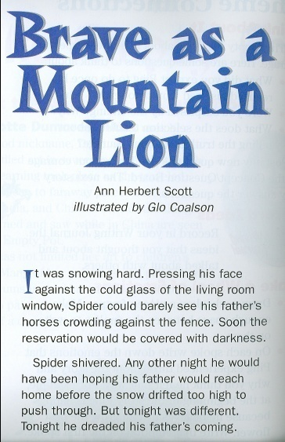

Building Background Knowledge
Notes:
Say: We are going to look at how this might look in the classroom. We’ll be seeing how one teacher planned to build background knowledge for this story, Brave as a Mountain Lion (Valiente como un puma), by Ann Herbert Scott.
This story takes place on a Shoshone reservation deep in the winter. The plot revolves around a Native American boy named Spider who is afraid to be in the school spelling bee. His family members give him advice to help him overcome his fears. They counsel him to be like the Wyoming wildlife around his home – brave as a mountain lion, clever as a coyote, and silent as a spider.
If I am going to be reading this story with my students, there will be many concepts they may be unfamiliar with – particularly if they have grown up in an urban setting. For example, they may not understand why Spider’s father follows the snowplow home so he can have a clear pathway. They may not know that mountain lions are one of the fiercest animals in the wilderness, more frightening to many people than bears. They may not know that the coyote is known as a clever animal in many Native American traditions. I will have to build this background knowledge.
I have assessed that my students will need to understand something about the setting on the Native American reservation during winter. Most crucial to their understanding, however, is that they understand about the various animals described in the story.
Open Court and Foro Abierto, 2nd Grade
Scott-Foresman Reading and Lectura, 3rd Grade

Slide 12
For new information to become part of memory students need:
3-4 exposures
No more than 2 days apart
Week prior to reading:
Monday: Read aloud a short article from social studies text about Native American reservations.
Tuesday: Point out Shoshone reservation on map. Discuss Wyoming climate.
Wednesday: PowerPoint slide show on Wyoming wildlife, including mountain lions and coyotes..
Friday: Quick review of what we have learned about Wyoming/ Shoshone Reservation.
(Nuthall, 1999).
Notes:
Say: In order to build background knowledge successfully, research tells us that our students will need 3-4 exposures to new content, no more than two days apart (Nuthall, 1999). Therefore, I decide that the week prior to reading this story, I’m going to spend a few brief minutes each day building some background knowledge. I will use the time after lunch when the students are settling in for the afternoon. Here’s what I decided to do.
Read box.
Say: Now, this may seem to be difficult to fit into my busy schedule. Remember that we will not need to plan so extensively for every story -- we only need to BUILD background knowledge when the story’s topic is very unfamiliar to our students. If I was reading a realistic fiction story about children in a familiar setting, I probably wouldn’t need to build background knowledge at all. We may decide that we can fit these opportunities to build background knowledge into our science or social studies time, or devote our after lunch read-alouds to these opportunities. When we understand how crucial background knowledge is to our students’ comprehension, finding time to build background knowledge should be a priority.

Slide 13
Activating Background Knowledge
Activating background knowledge should take just a few moments.
We should activate background knowledge that is crucial to understanding the text.
The background knowledge we activate should be linked to our purpose for reading.
Notes:
Say: Most of the time, we will not need to build background knowledge. We will simply activate existing knowledge. We do this when students already have some background knowledge of the topic of the text.
After we have helped students to build background knowledge about a concept, we must be sure to activate that background knowledge each time we read. We might go through a routine, such as previewing the text by skimming, looking at photos or pictures, noticing headings and other text features, and we may even pre-teach some vocabulary. These can be useful approaches, but we must think about making our activation of background knowledge as effective as possible.
When teaching reading comprehension, the bulk of our instruction should occur during reading. We shouldn’t need to spend 5 or more minutes activating background knowledge prior to reading. In previewing text, we must remember that we do not want to take the problem-solving away from our students. For example, if we preview and discuss the entire text, I might give away the plot, taking away my students’ abilities to make predictions and inferences.
Instead, we might think carefully about which background knowledge will be most crucial to our students while they read. For example, some vocabulary can be briefly addressed during reading. Other vocabulary is absolutely essential to understanding, so we might choose that word to pre-teach.
When choosing the most crucial information, we want to consider our purpose for reading and link activating background knowledge to this purpose.

Slide 14
Making Connections?
Why Should We Teach
Notes:
Say: Let’s begin by discussing why we should teach this strategy to students.

Slide 15
Making Connections
“We are turning out lots of superficial readers. They look and sound competent. They read smoothly and retell what they’ve read with some detail, but they are unable to go further – to discuss why characters behave as they do, to give a concise summary, to discuss the theme or big ideas, to talk about the author’s purpose.” (Routman, 2003)
Notes:
Say: Can you make a connection to this quote?
Read Slide
Say: How many of you can relate to what Regie Routman says?

Slide 16
Why Teach Making Connections?
Connections help readers:
Relate to characters
Visualize
Avoid boredom
Pay attention
Listen to others
Read actively
Remember what they read
Ask questions
                (Tovani, 2000)
Notes:
Say: As discussed, accessing background knowledge increases our ability to retain new information (e.g. Recht and Leslie, 1988) and understand challenging text because it provides something for text information to “stick” to. New learning is incorporated into our background knowledge.
Now let’s think about how good readers use background knowledge to make connections while reading. Using background knowledge to make connections to the text helps enrich our understanding of the text.
Understanding more deeply impacts us in many ways. It gives us insight into the world and empathy for others, it creates within us a desire to read and re-read, and helps us to see how the world works (Keene, 2008).
We teach Making Connections because it helps us to bring enjoyment to reading.
Cris Tovani (2000) lists several ways Making Connections increases our interest and enjoyment in reading.
Read slide.

Slide 17

Why Teach Making Connections?
Students are expected to:
3.5(B): compare and contrast the settings in myths and traditional folktales.
4.3(B): compare and contrast the adventures or exploits of characters (e.g. the trickster) in traditional and classical literature.
5.11(E): synthesize and make logical connections between ideas within a text and across two or three texts representing similar or different genres.
Figure 19(C): monitor and adjust comprehension (e.g., using background knowledge …);
Figure 19(F): make connections (e.g., thematic links, author analysis) between literacy and informational texts with similar ideas and provide textual evidence.
Notes:
Say: Why should we teach Making Connections? We’ve already discussed how making connections impacts comprehension, let’s think about how making connections is addressed in our state curriculum.
Making Connections is such a foundational strategy that we can find it in several of our TEKS. Here we see a sampling of TEKS which deal directly with Making Connections. Many other TEKS require that students make connections to background knowledge. We also know, because background knowledge is fundamental to acquiring new knowledge, that our students must be able to make connections to meet expectations in content area instruction.

Slide 18

Why Teach Making Connections?
Improving comprehension instruction for ELLs includes:
Actively engaging students in monitoring, carefully selecting strategies, and reflecting on use of strategies.
Helping students to understand how to adjust for the type of text being read, the purpose for the reading, and the format of the content.
Alignment of comprehension instruction across the curriculum so students have opportunities to transfer and adapt strategies to new contexts.
(Francis, Rivera, Lesaux, Kieffer, & Rivera, 2006; Dresler 7 Kamil, 2006; Genesee, Geva, Dressler, & Kamil, 2006; Lesaux, Lipka, & Siegle, 2006; Roit, 2006.)
Notes:
Say: We learned in Cognitive Strategy Routine that reading comprehension is an area of difficulty for English Language Learners. We can help ELLs learn strategies that enable them to comprehend what they read. Teachers can also help ELLs by providing instruction in the following ways.
Read slide.
(Francis, Rivera, Lesaux, Kieffer, & Rivera, 2006; Dresler 7 Kamil, 2006; Genesee, Geva, Dressler, & Kamil, 2006; Lesaux, Lipka, & Siegle, 2006; Roit, 2006.)

Slide 19
Making Connections?
How Do You Teach
Notes:
Say: We’ve looked at many reasons why it is important to teach the cognitive strategy Making Connections. Many of you teach this strategy to students, today however, we want to take about ways to make this instruction even more effective.

Slide 20
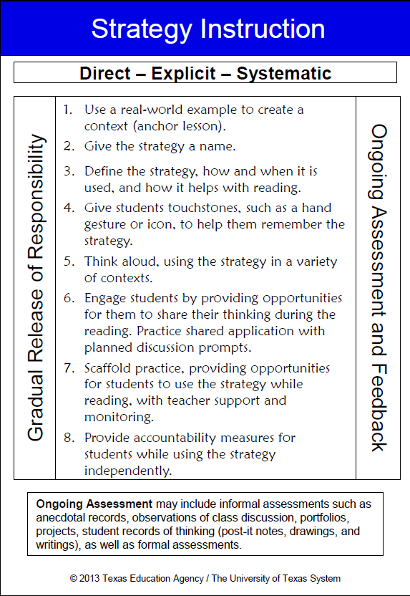
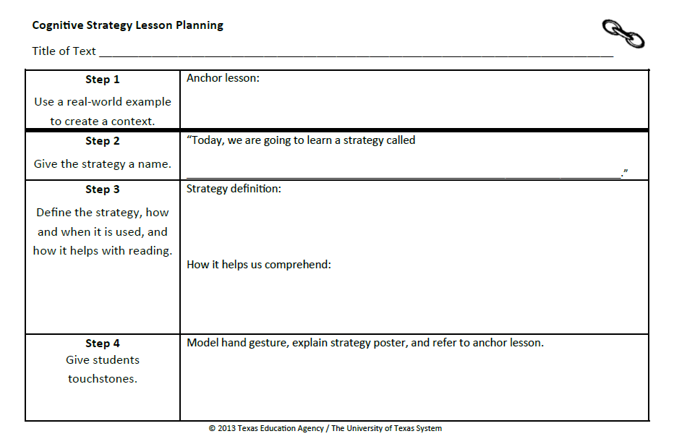
Introducing Cognitive Strategies
Notes:
Say: When we introduce a new cognitive strategy to our students, we must do so in a way that is direct, systematic and most of all, explicit. Students should understand what the strategy is and how it helps them understand. “… instruction should use modeling, thinking aloud, questioning, and other techniques to promote active construction of meaning” (Moats, 2005).
We have developed a routine to introduce and practice cognitive strategies. This routine is an 8 step process for directly and explicitly teaching strategies to students. Let’s review the steps now. Please take out your blue and white Strategy Instruction card and take a moment to read the 8 steps.
Allow participants one minute to review the steps on the card.
Say: You will also need the orange Cognitive Strategy Routine Lesson Planning Card and a vis-à-vis for this part of the session.

Slide 21
Step 1: Anchor Lesson
“Today, we are going to explore our background knowledge. Did you know that everyone has background knowledge? Background knowledge is another way for saying, ‘What I know.’ You have lots of background knowledge because you know a lot about many things. We get background knowledge from doing things, seeing things, going places, from reading, and talking with others.”
Notes:
Say: As you recall, step 1 in our cognitive strategy routine is introducing the strategy with an anchor lesson. An anchor lesson is a simple stand-alone lesson that we can refer to when we discuss making connections in future lessons. This lesson should take approximately 20-30 minutes and should be done the day before you want to introduce the strategy with a piece of text. An anchor lesson does not typically involve text, it should be a memorable activity that demonstrates the strategy.
Read slide.

Slide 22

Notes:
Say: Look at this picture of a car. I think that you all have some background knowledge about cars. What do you know about cars? Think for a moment. Turn and tell your partner everything you know about cars.
Provide time for partners to talk. Select 3-4 people to share what they know about cars. Record the information on a blank piece of chart paper as it is shared. Ask participants to explain why they know what they do about cars. Reinforce that they know what they know because it’s part of their background knowledge.
Say: I noticed that some of you have lots of background knowledge about cars perhaps because you’re very interested in cars. Some of you might not know about engines and pistons, but you still know about cars. Everyone has his or her own background knowledge. We use our background knowledge to make connections to new things we hear, see, or read. When we make connections, it helps us to understand and remember things. Background knowledge is like velcro in our brains. Connecting new information to what we already knows helps the new information stick in our brains.
You might choose to model how a piece of Velcro works as you explain this to students.

Slide 23






My Background Knowledge
Notes:
Say: We all have background knowledge. What do you know a lot about? I know a lot about …
On the slide, add pictures of things you know about. Be prepared to explain why/how the things you show are part if your background knowledge.
Say: In class, I would invite my students to create their own background knowledge poster or to represent their background knowledge in some other way. For example, I might have students create a head shape (bust) out of clay. I would then have them write about what they know on thought clouds and have them tape the thought clouds to toothpicks so that they can stick them into their clay heads. As students share their work, you can reinforce both the uniqueness of their background knowledge and how their background knowledge connects to other students’ background knowledge.
This would be our anchor lesson for Making Connections. In the future, I could remind students, remember when we made our background knowledge posters and you demonstrated some of the things you know a lot about? This activity becomes an anchor.

Slide 24
Step 1: Anchor Lesson
Use a real-world example to create a context.
Record what you will do for Step 1 on your orange Cognitive Strategy Lesson Planning Card.
Notes:
Say: Now it is your turn to think about Step 1. How will you introduce Making Connections to your students? Using a Vis-à-vis marker, please take a moment now to record on your orange Cognitive Strategy Lesson planning card what you will do for an anchor lesson. You might choose to do the same anchor lesson I modeled, or you might have a different idea of how to provide a real-world example to help your students understand the concept of Making Connections. Regardless, take a moment now to record what you will do for your anchor lesson in the space provided for Step 1.
Provide time for participants to compete Step 1 on their orange Cognitive Strategy Lesson planning card.

Slide 25
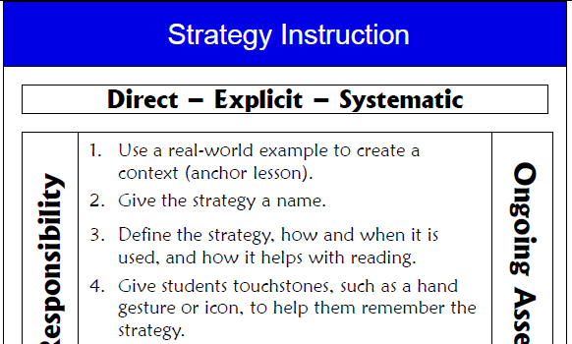
Teaching the Strategy (Steps 2-4)
Notes:
Say: An anchor lesson is our introduction to the strategy. Steps 2-7 are how we teach the strategy. These next three steps do not change. We will repeat what we plan to say and do for the next three steps EVERY time we teach this strategy. We do these three steps before every think-aloud.

Slide 26
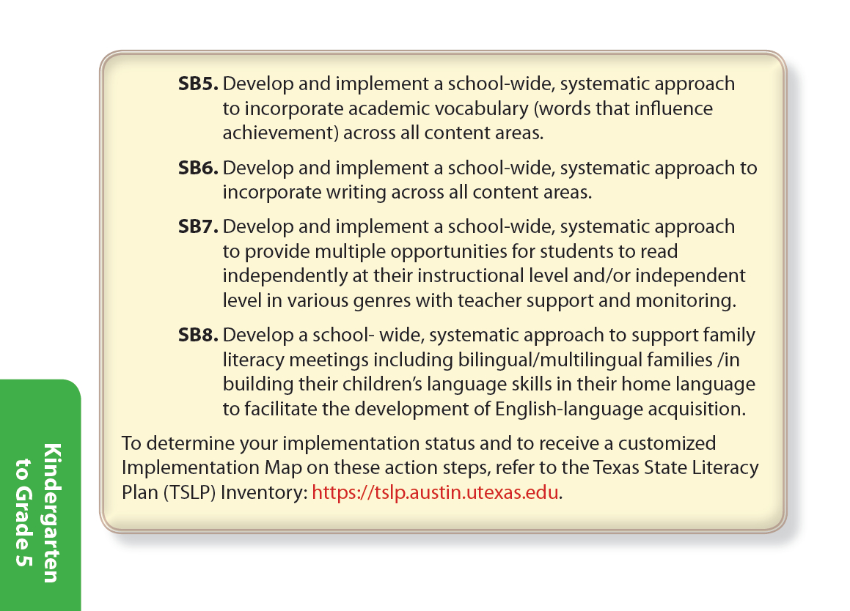
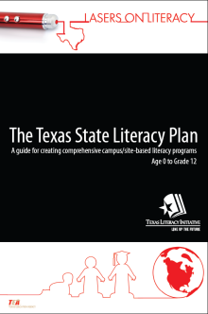
Step 2: Give the Strategy a Name
“Today we’re going to learn a strategy called Making Connections.”
Notes:
Say: Step 2 is, “Give the strategy a name.” We want to use clear and consistent language when referring to the cognitive strategies. Our comprehension strategy instruction is stronger if everyone in the school, from kindergarten to twelfth grade, uses the same vocabulary to refer to the strategies we are teaching. In fact, developing a common academic vocabulary is so important, that it’s even listed as an Action Step in Standards-based Instruction in the TSLP.
SB5: Develop and implement a school-wide, systematic approach to incorporate academic vocabulary (words that influence achievement) across all content areas.

Slide 27
Step 2: Give the Strategy a Name
“Today we’re going to learn a strategy called Making Connections.”
Record what you will say for Step 2 on your orange Cognitive Strategy Lesson Planning Card.
Notes:
Read red text and the bottom part of the slide.
Provide time for participants to compete Step 2 on their orange Cognitive Strategy Lesson planning card.

Slide 28
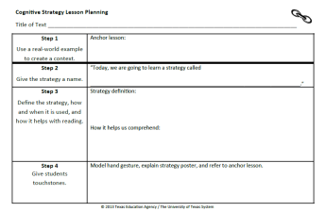
Step 3: Tell Why and How it is Used
Strategy Definition:
“We are going to learn how to use our background knowledge to help us understand what we are reading. When something in the text reminds us of something we know, we call that making a connection.”
How it helps us understand:
“When we make connections while reading, it helps us understand and remember the text better.”
Notes:
Say: Step 3, is where we tell why and how the strategy is used. This type of explicit instruction is critically important. When teachers explain concepts and skills through concrete, visible examples; provide clear, consistent routines; and maintain high expectations that are communicated to students, levels of both teaching and learning increase (Vaughn Gross Center for Reading and Language Arts, 2012).
To explicitly explain Making Connections to my students, I might say something like this, “Yesterday we explored background knowledge. We discovered that you each know a lot about many things and have lots of background knowledge. Today, we are going to learn how to use our background knowledge to help us understand what we are reading. When something in the text reminds us of something we know, we call that making connections. When we make connections while reading, it helps us understand and remember the text better.”

Slide 29
Step 3: Tell Why and How it is Used
Record what you will say for Step 3 on your orange Cognitive Strategy Lesson Planning Card.
Making Connections…
Notes:
Read slide.
Provide time for participants to compete Step 3 on their orange Cognitive Strategy Lesson planning card.

Slide 30

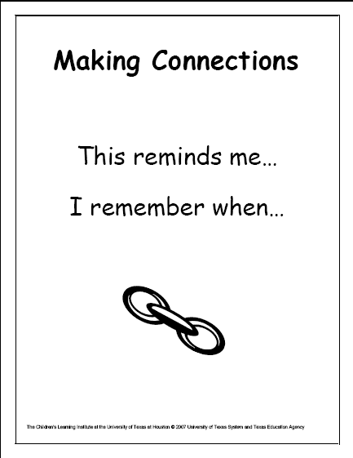

Step 4: Touchstones
Provide students with a hand motion that signals “Making Connections”
Display strategy poster in the classroom
Notes:
Say: When a new strategy is introduced, we provide a kinesthetic hand motion that helps our students remember the strategy, and provides one way they can signal to us that they are using the strategy as they read.
Model hand motion; cross the fingers on one hand to indicate they are connected.
Say: I would explain to my students that this hand signal represents two things (fingers) connecting. When I make connections in a think-aloud, I will use the hand signal so my more visual learners will see the strategy in action. My more kinesthetic children may do the signal along with me. All students may use the signals when they make connections in their own reading.
We also display a poster in the classroom that contains key words students will want to use and an icon of a chain link that represents connections. The hand signal, visual icon, and the anchor lesson remind students what the strategy is and why the it is helpful to use while reading.

Slide 31
Step 4: Touchstones
Touchstones: Model hand gesture, explain strategy poster and refer to the anchor lesson.
“See this Making Connections strategy poster? Is shows a chain link. The two links are connected. This poster helps us to remember that good readers make connections when they read. Today when I am reading, I will show you when I am making a connection to the text by crossing my fingers to make them connect. Remember, a connection is when something in the text reminds us of something in our background knowledge. For example, we all have background knowledge of cars.”
Notes:
Say: I might explain the touchstones to my students like this.
Read slide.

Slide 32
Step 4: Touchstones
Record what you will say for Step 4 on your orange Cognitive Strategy Lesson Planning Card.
Notes:
Say: Work with others at your table. How will you explain the touchstones to your students.
Read slide.
Provide time for participants to compete Step 4 on their orange Cognitive Strategy Lesson planning card.

Slide 33
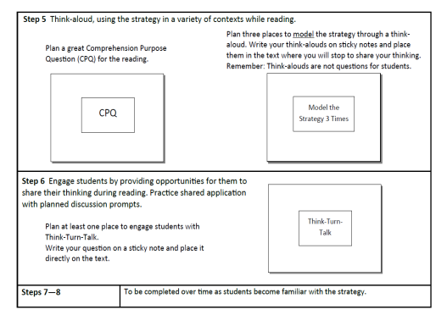
Step 5: Think Aloud (Side 2)
Step 5 is where we SHOW students how we use the strategy while reading.
We plan a comprehension purpose question (CPQ) as well as places to model thinking aloud for students.
Step 5 will differ with each lesson. We transfer the sticky notes from the planning card and place them right on the text.
Notes:
Say: After I have introduced the strategy’s definition and given my students touchstones to aid memory, I think aloud to model how the strategy helps me comprehend while reading. Think-alouds bring invisible thought processes to students’ attention, and increase students’ ability to read strategically (Duffy, et. al, 1987).
Read slide.

Slide 34

Step 5: Think Aloud
Pages 13-29
CPQ: What does Brian do to try and help the situation.
“As we read chapter 2, I will stop and think-aloud some of the connections I make while reading.”
Notes:
Say: Eventually, we will model with a variety of genres and text types. When beginning a strategy, however, it is important to choose texts which are well-suited to the particular strategy (Duke & Pearson, 2002).
Hatchet is a commonly used book in fifth grade classrooms. I might decide to use Chapters 1 and 2 of Hatchet as the place I want to begin modeling Making Connections for my students.
As always, I want to set a CPQ for the reading. Today, I will be reading Chapter 2 with the class. My CPQ is: What does Brian do to try and help the situation? Remember, I try to set a CPQ that relates to the strategy I am focusing on. In this chapter, Brian tries to control the situation by flying the plane. Many students should be able to connect his actions for flying a plane to playing a video game. Brian also gets frustrated when the radio doesn’t work. Students should be able to connect to a time when they felt frustrated that something didn’t work quite right. Students also might be able to connect to a time when they felt panicked, or hopeless, or a time when they tried to think through various scenarios to make a difficult decision.
Now I will do a brief think-aloud for you as if you were students in my class. Let’s pretend that I’ve been reading chapter 2, and I’ll start on page 14. You can follow along with me in your handout. You’ll find the excerpt for Hatchet on Handout #2.
Read aloud from the excerpt stopping to model thinking aloud in at least two places.
Example: Paragraph 1. “… still strapped in with his seatbelt.”
I’m making a connection here. I know about CPR but I wouldn’t know exactly what to do. I’ve seen it on T.V. but I haven’t actually been trained in what to do. I also would be so scared and panicked that I’d be trembling like he is. My connection helps me to understand how scared Brian must feel. He must have all sorts of things racing through his mind right now.
Continue reading. End of page 14.
“I’m making a connection to a time when I was flying to El Paso. There were a lot of turbulence. That means that the plane was bumping around a lot. All of a sudden the plane started to dive down. I was really scared. I thought we were going to crash! My connection helps me to understand how Brian is feeling. He probably has that sick feeling in his stomach and he probably thinks he’s going to crash.

Slide 35
Step 6
Engage students by providing meaningful opportunities for them to share their thinking during the reading. Practice shared application with planned discussion prompts.
p. 20. “Let’s think for a moment. How do you think Brian is feeling right now? Can you make a connection to how he’s feeling?”
Turn and talk to your partner.
Notes:
Say: In Step 6 of the Cognitive Strategy Routine, students and teacher share responsibility for using the strategy. Though we continue to model some of the connections we have, we also ask students to share their connections with the class. We use the Think-Turn-Talk routine as a way to keep all students engaged and accountable for the learning. For example, as we continue to read chapter 2 of Hatchet, we might stop and use the following prompt so that students have the opportunity to apply the strategy:
Read the text in red on the slide.
We show our students that we value their authentic connections by recording them for the class to see. We might write them on chart paper or on sticky notes that we place in the text.

Slide 36
How Can We Help Our Students
Make Connections?
Carefully preview texts and choose texts to which students can relate.
Model authentic connections by thinking through the text yourself before reading with the students.
Be explicit about the ways connections help you understand.
  When modeling, use the stems, “That reminds me of …” and “That helps me understand the text better because …”
  Post these stems for student reference.
Notes:
Say: How can we help our student make connections?
Read first bullet.
Say: Although in the future we want our students to be able to relate to many different texts, in the beginning texts “… should be chosen to be particularly well-suited to application of the specific strategy being learned” (Duke & Pearson, 2002). For example, we might choose books in which characters have emotions or experiences that students will find familiar. As they become more proficient at the strategy, we broaden the scope of texts to which they apply the strategy, or in other words, we “… move from close to home to more global issues or cultures and places further removed from most children’s lives.” (Harvey & Goudvis, 2007).
Read next two bullets.

Slide 37
Caution
Surface-level Connections
Example: “That character has the same name that I do!”
Model: “That helps me understand better because …”
Ask: “How does that help you understand?”
Distracting Connections
Example: “That character has a dog, and I have a dog, and one time we took the dog to the lake. We went fishing at the lake. We ate the fish for dinner. I don’t like fish. I like pizza.”
Notes:
Say: Sometimes our students bring up connections that do not help us make meaning from text – in fact, they may bring up connections that take us away from understanding.
Click to reveal text box.
Say: When our students begin Making Connections, they often bring up surface-level connections.
Ask a participant to read the example on the slide.
Say: In the beginning, we encourage students to make all kinds of connections – although many teachers find that their students will make connections with no prompting at all! As our students become more proficient, we must steer them toward connections that lead us deeper into the text, rather than just “surfing” along the top of it.
Click to reveal text box.
Say: Another type of connection is a distracting connection.
Ask a participant to read the example on the slide.
Say: As Harvey & Goudvis (2007) have said, “Distracting connections actually cause our minds to wander from the text and disrupt meaning. … There is nothing wrong with indulging a particular connection for a moment or two. The problem is continuing to read while doing it!”
So, how do we avoid the pitfalls of surface-level and distracting connections?
Click to reveal new text box.
Say: We must first model, using the stem “That helps me understand better because …” Once we have modeled many times, we can begin to ask our students to describe how their connections help them understand.
Say: We must remind students to be cautious of the distractors during testing. The distractors may look very much like the correct answer. Tell students to be sure and use the stem when faced with what may be a distractor.

Slide 38

Caution
Weak readers often have difficulty understanding text because they make connections to background knowledge that is irrelevant to the reading task. When students are directly taught to integrate background knowledge with the text, however, they do better on comprehension measures.
(Hansen, 1981; Pressley, 2002)
Notes:
Read slide.

Slide 39
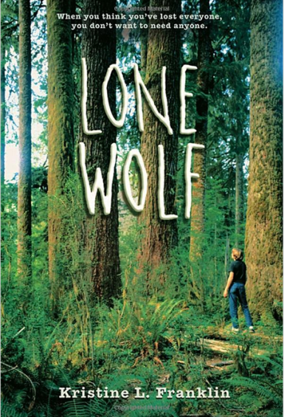
Step 7: Scaffolded Practice with Support
Scaffold practice, providing opportunities for students to use the strategy while reading with the teacher’s support and monitoring.
“Today when you read Chapter 1 of Lone Wolf, I want to be aware of the connections you make. As you read, place a sticky note in your book whenever you make a connection. When you are finished reading the chapter, complete the 3 column chart we use for Making Connections and be prepared to share your thinking during small group discussion.”
Notes:
Say: Step 7 of the Cognitive Strategy Routine, is scaffolded practice with support.
Read the black text on the slide.
Say: In grades 3-5, we might choose to model and practice application of the strategy while navigating the class read aloud text. In our example, this would be Hatchet. This type of instruction is not sufficient however. I also would be conducting small group reading instruction during part of the reading block, where I would have students in groups of 6-10 reading a book at an appropriate instructional level for the group, that dealt with a similar topic or theme. During small group instruction time, I would listen to one student at a time read a small portion of the assigned text and would have them share their thinking out loud with me so that I could check on their strategy use and general comprehension. I would ensure that the other students were engaged in the reading until it was their turn for me to listen to them read.
Read the red text on the slide.

Slide 40
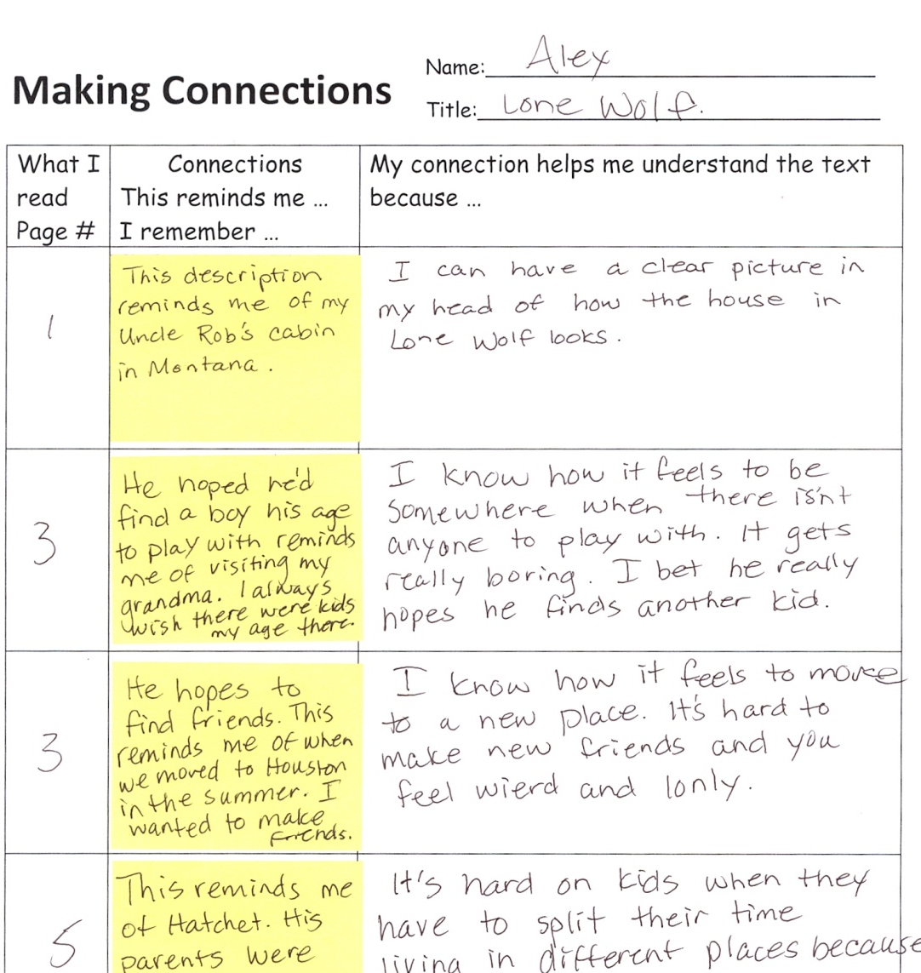

Making Connections 3 Column Chart
Chapter 1 CPQ: Who is the main character and whet do we learn about him?
Notes:
Say: This is an example of what students might record on a 3 column chart. They would take their sticky notes out of their text and place them on this strategy sheet. Of course, I would have modeled this for students during my think-aloud before I would expect them to complete it independently.
As we gradually release responsibility of the strategy to our students, we provide supports, or scaffolds, which will promote application by helping students to bring the strategy to a conscious level. “Learners can temporarily rely on these hints and suggestions until they create their own internal structures (Scardamalia & Bereiter 1985)” (Rosenshine, Meister, & Chapman, 1996, p. 205). Once readers have internalized the strategy, they no longer need to rely on these scaffolds.

Slide 41
Step 8: Accountability
Provide accountability measures for students when using the strategy independently.
“Today when you are reading independently, I want you to be aware of the connections you’re making while reading. When the timer goes, I would like you to stop reading and complete a quick-write in your Reading Reflection Journal, explaining the connections you made while reading.”
Notes:
Say: In Step 8 of the Cognitive Strategy Routine, we ask students to continue using the strategy in their independent work. We also assess how they use the strategy and whether we will need to return to earlier stages of the routine.
Read the red text on the slide.

Slide 42

Step 8: Accountability
Different Kind of Champion: Chapter 2
When Ranny went missing and everyone wanted to give up looking for him, it reminded me of the time my dog Max went missing. We looked for him for a long time and it seemed like everyone was going to give up. There was no way I was going to give up. I was determined just like Jag. When Jag finally found Ranny and she was hurt, it also reminded me of the time when Max got attacked by another dog. It was awful. I was so worried about him. I was really upset. We had to rush him to the animal hospital too.
Notes:
Say: Here is an example of a quick-write a student wrote during independent reading time.
Read example on the slide.

Slide 43
Making Connections
Other Considerations When Teaching
Notes:
Say: Now that we’ve experienced how we would teach Making Connections following the Cognitive Strategy Routine, let’s think about other aspects of teaching Making Connections that we should be sure to consider.

Slide 44
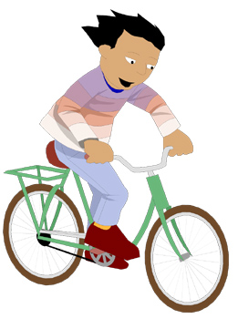


3 Types of Connections
Text-to-Self
Text-to-Text
Text-to-World
Notes:
Say: When teaching Making Connections, we should be aware that there are three types of connections readers make to text.
Read slide.
Say: Let’s take a brief moment to understand these types of connections and how this understanding might impact our instruction.

Slide 45
3 Types of Connections
Text-to-Self:
“Connections between the text and the reader’s experiences and memories. The more experiences and memories a reader has about a topic, the easier the material is to read.”
(Tovani, 2000)
Notes:
Read slide.
Say: The baseball example at the beginning of the session helped to reinforce how personal connections can impact comprehension.

Slide 46
3 Types of Connections
Text-to-Self:
    What does this story remind you of?
    Can you relate to the characters in the story?
    Does anything in this story remind you of anything in your own life?
http://www.readwritethink.org/professional-development/strategy-guides/making-connections-30659.html
Notes:
Say: Typically, we begin Making Connections instruction by focusing on text-to-self connections. For example, we ask students to think about the following:
What does this story remind you of?
Can you relate to the characters in the story?
Does anything in this story remind you of anything in your own life?

Slide 47
3 Types of Connections
Text-to-Text:
“Connections the reader makes between two or more types of texts. The reader may make connections relative to plot, content, structure, or style.”
(Tovani, 2000)
Notes:
Read slide.

Slide 48


3 Types of Connections
Text-to-Text:
    What does this remind you of in another book you have read?
    How is this text similar to other things you have read?
    How is this text different from other things you have read?
http://www.readwritethink.org/professional-development/strategy-guides/making-connections-30659.html
Notes:
Say: Teachers might prompt students to make text-to-text connections by asking the following questions:
What does this remind you of in another book you have read?
How is this text similar to other things you have read?
How is this text different from other things you have read?
http://www.readwritethink.org/professional-development/strategy-guides/making-connections-30659.html

Slide 49
3 Types of Connections
Text-to-World:
“Connections the reader makes between the text and what he knows about the world (facts and information).”
(Tovani, 2000)
“A connection between the text and something that is occurring or has occurred in the world.”
(IRA/NCTA, 2003)
Notes:
Say: The third type of connection readers make is Text-to-World.
Read Slide.
http://www.readwritethink.org/files/resources/lesson_images/lesson228/world.pdf

Slide 50
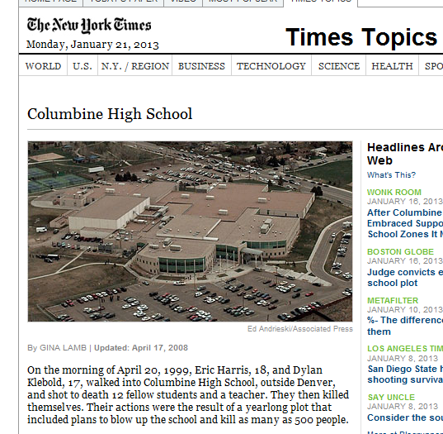
3 Types of Connections
Text-to-World:
    What does this remind you of in the real world?
    How are events in this text similar to things have happened in the world?
    How are events in this text different from things that have happened in the world?
Notes:
Say: Teachers might prompt students to make Text-to-World connections by asking the following questions:
What does this remind you of in the real world?
How are events in this text similar to things have happened in the world?
How are events in this text different from things that have happened in the world?
Adapted from http://www.readwritethink.org/files/resources/lesson_images/lesson228/world.pdf

Slide 51
Tips (Steps 6-8)
  Introduce text-to-text and text-to-world connections when most students are able to make text-to-self connections.
  Allow students to make connections to non-print texts (i.e. movies, video games, television, and music).
  Use graphic organizers to chart relationships between texts.
Notes:
Read slide.

Slide 52
Keep In Mind …
Making Connections is the foundation for many of the other cognitive strategies good readers use. It is important that students have a good understanding of background knowledge, and how they use their background knowledge to make connections during reading.
Notes:
Read slide.
Say: Once students have a strong foundation in Making Connections, we can feel confident in moving on to teaching them to use other strategies in conjunction with Making Connections.

Slide 53

Planning With Your Core Program
YOU DO:
Look at text that you will be using in class next week.
Plan a CPQ for the text that will link to the strategy of Making Connections.
Plan three places to model Making Text-to-Self Connections. Place sticky notes in the text right where you will stop to model the connections that you are making.
Notes:
Read slide. Allow participants time to plan. Encourage participants to talk to others at their table and plan together. Provide support by walking to participant tables and engaging in discussion and asking/answering questions.

Slide 54
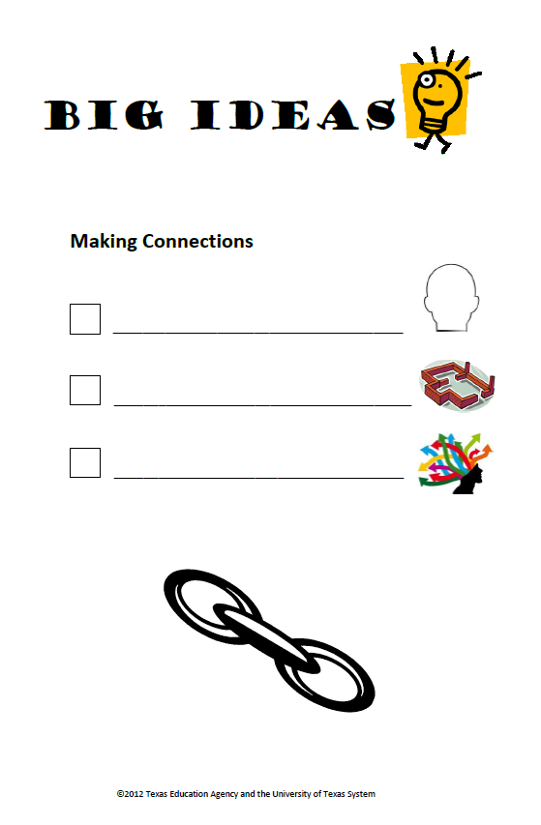
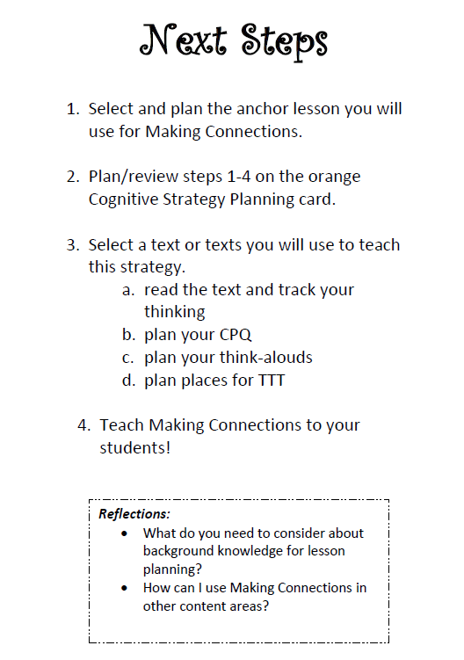
Big Ideas
Activate/build
background knowledge
Making Connections =
foundational strategy
Understand
distracting connections
Notes:
Review Big Ideas card.

Slide 55
“Background knowledge is a repository of memories, experiences, and facts. When information is read in isolation and not connected to existing knowledge, it is forgotten and deemed unimportant. Calling on existing knowledge and experiences is crucial if readers are to assimilate new information.”
~ Cris Tovani
Notes:
Say: Thank you for attending this session. Please feel free to ask any questions.

Slide 56
References
Bradford, K. (1999). A different kind of champion. Toronto, Canada: Scholastic Canada, Ltd.
Dressler, C. & Kamil M. (2006). First- and second-language literacy. In D. August & T. Shanahan (Eds.),
Developing literacy in second-language learners: A Rreport of the National Literacy Panel on Language Minority Children and Youth. Mahwah, NJ: Lawrence Erlbaum Associate.
Francis, D., Rivera, M., Lesaux, N., Kieffer, M., & Rivera, H. (2006). Practical guidelines for the education
of english language learners: Research-based recommendations for instruction in academic interventions. Available at http://www.center oninstruction.org/files/ELL1-interventions.pdf
Franklin, K. L. (1997). Lone wolf. Cambridge, MA: Candlewick Press.
Frank, A. & Martin, C. (1989). The diary of anne frank. New York: Gardens Books.
Genesee F., Geva, E., Dressler, D., & Kamil, M. (2006). Synthesis/; Cross-linguistic relationships. In D.
August & T. Shanahan (Eds.), Developing literacy in second language learners: A report of the National Literacy Panel on Language Minority Children and Youth. Mahwah, NJ: Lawrence Erlbaum Associates.
Hansen, J. (1981). The effects of inference training and practice on young children's reading
comprehension. Reading Research Quarterly , 391-417.

Slide 57
References
Harvey, S. & Goudvis, A. (2000). Strategies that work: Teaching comprehension to enhance
understanding. York, ME: Stenhouse Publishers.
Lesaux, N.K., Lipka, O., & Siegel, L.S. (2006). Investigating cognitive and linguistic abilities that influence
the reading comprehension skills of children from diverse linguistic backgrounds. Reading and writing: An interdisciplinary journal, 19(1), 99-131.
Lowry, L. (1989). Number the stars. Boston, MA: Houghton Mifflin Harcourt Publishing Company.
Martin, R. (1992). The rough faced girl. New York: Puffin Books.
Marzano, R. (2004). Building background knowledge for academic achievement. Alexandria, VA:
ASCD.
Nuthall, G. (1999). The way students learn: Acquiring knowledge from an integrated science and
social studies unit. The Elementary School Journal , 99 (44), 303-341.
Paulsen, G. (1987). Hatchet. New York, NY. Aladdin Paperbacks, Simon and Schuster Children’s
Publishing Division.
Pressley, M. (2000). What should comprehension instruction be the instruction of? In M. Kamil, P.
Mosenthal, P. Pearson, & R. Barr (Eds.), Handbook of reading research: Volume III. Mahwah,
NJ: Lawrence Erlbaum Associates.

Slide 58
References
Pressley, M. (2002). Comprehension strategies instruction: A turn-of- the-century status report. In
C.C. Block &amp; M. Pressley (Eds.), Comprehension instruction: Research-based best
practices. New York: Guilford Press.
Read Write Think, IRA/NCTA: 2003. Making connections: Text-to-world connection. Retrieved January
10, 2013, from http://www.readwritethink.org/files/resources/lesson_images/lesson228/world.pdf
Recht, D., & Leslie, L. (1988, March). Effect of prior knowledge on good and poor readers'
memory of text. Journal of Educational Psychology, 80(1), 16-20. Retrieved June 23, 2008,
doi:10.1037/0022-0663.80.1.16
Roit, M. L. (2006). Essential comprehension strategies for English learners. In T.A. Young & N.L. Hadaway
(Eds.), Supporting the literacy development of English learners: Increasing success in all classrooms (pp. 80-95). Newark, DE: International Reading Association.
Routman, R. (2003). Reading Essentials: The specifics you need to teach reading well. Portsmouth,
NH: Heinemann.

Slide 59
References
Sanderson, R. (2002). Cinderella. New York: Little Brown and Company.
Scott, A. (1996). Brave as a mountain lion. In Open Court Reading, (2000). Grade 2, Book 2.
WrightGroup/McGraw-Hill.
Scott, A. (1996). Brave as a mountain lion. In Scott Foresman Lectura, (2000). Grado 3, Unidad 3. Upper
Saddle River, NJ: Pearson Education.
Simon, C. (n.d.) Making Connections. Retrieved January 17, 2013, from
http://www.readwritethink.org/professional-development/strategy-guides/making-
connections-30659.html
Tovani, C. (2000). I read it, but I don't get it: Comprehension strategies for adolescent readers.
Portland, ME: Stenhouse Publishers.
Wilhelm, J. (2004). Reading is seeing: Learning to visualize scenes, characters, ideas, and text
worlds to Improve comprehension and reflective reading. New York: Scholastic, Inc.

