Slide 1

Making Inferences and Predictions
Grades 3 – 5
Notes:
Introduce self and welcome participants.
Let’s begin by reviewing the materials you need for this training.
(Hold items up as you talk.)
Say: You will have three sets of handouts. You will have a PowerPoint Presentation Handout, Additional Handouts and Excerpt Handouts. You will also need the blue and white Cognitive Strategy Routine card, the orange Cognitive Strategy Lesson Planning card (with sticky notes) and the Inferring Support Poster. You will need some large and small sticky notes as well.

Slide 2

“ Inferring is the bedrock of comprehension, not only in reading. We infer in many realms. Our life clicks along more smoothly if we can read the world as well as text. Inferring is about reading faces, reading body language, reading expressions, and reading tone as well as reading text.”
(Harvey & Goudvis, 2000, p. 105)
Notes:
Say: Making inferences helps us to achieve deeper understanding of every text we read and it also helps us to navigate through life a lot better – for example, understanding a joke or knowing what mood our spouse is in.
In their book, Harvey and Goudvis (2000) say:
Read the slide.

Slide 3

Big Ideas
Importance of explicit instruction.
Scaffold for success.
Across content areas.
Notes:
Say: Let’s discuss the “Big Ideas” we hope you will take away from this training.
The first Big Idea we want you to take away is the “Importance of explicit instruction.” These are complex skills that require explicit instruction in order for students to be successful. Explicit instruction that begins with an anchor lesson and strategy instruction that follows a clear routine will set students up for success.
The second Big Idea we want to impress upon you is, “Scaffold for success.” We want to provide supports to enable our students to be successful and gradually fade those scaffolds. Providing students with an organized way to record their thoughts and help to look for and analyze inferences is important. These scaffolds can be gradually faded over time.
The last Big Idea we hope that you’ll leave this session with is that teaching making inferences and predictions is something we do “Across content areas.” We see that these are not just thinking processes we expect students to use in ELA. Instead, these are the thinking processes we want to teach our students in every subject area for many years.

Slide 4

Goals for This Training
Clarify what Making Inferences and Predictions includes.
Recognize the importance of teaching Making Inferences and Predictions.
Practice a routine for planning and teaching Making Inferences and Predictions.
Understand how to teach Making Inferences and Predictions with informational text.
Notes:
Read slide.
Say: You will see how our Cognitive Strategy Routine can be used to teach our students to make inferences and predictions. Teaching inferring is one of the most challenging things we can teach to students. For this reason, you will see that today, we will model using multiple examples and we will give you opportunities to work through a few examples as well.

Slide 5
MAKING INFERENCES and PREDICTIONS?
What Is
Notes:
Say: Before we delve into why or how we teach inferring and predicting, let’s begin by talking about what we think the strategy of Making Inferences and Predictions is.

Slide 6
Making Inferences and Predictions
Inference: “A logical conclusion based on background knowledge and clues in the text. Inferences are not explicitly confirmed in the text.”
Prediction: “A logical guess based on the facts. It is either confirmed or disproved by the text.”
(Tovani, 2000, p. 105)
Notes:
Say: What are the differences between the making an inference and predicting? Cris Tovani, author, consultant and high school reading teacher describes it this way:
Read slide.
Say: A prediction therefore, is a type of inference. We use information from the text in combination with our background knowledge to make a prediction. As we teach students to make predictions, it is important for teachers to ensure that students take time to read on and confirm that their predictions were accurate. If prediction are not confirmed, then students can modify their predictions once they have gathered more information from the text.

Slide 7
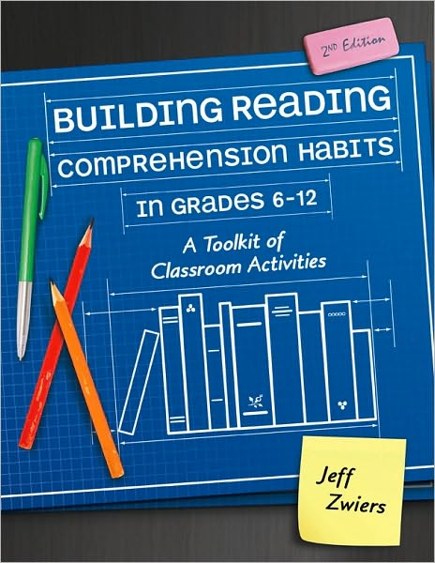

Building Reading Comprehension Habits
Handout
1
CPQ: What do you learn about inferring and predicting from reading the excerpt?
Notes:
Say: You will find the excerpt in your Additional Handout packet. It is Handout 1. As you read, please think about the following CPQ:
What do you learn about inferring and predicting from reading the excerpt? You may wish to highlight important information as you read. Feel free to share your thinking with a partner when you are done reading.
Provide time for participants to read and discuss. You do not need to have them share out whole group.
Say: Let’s now consider what inferring actually includes.

Slide 8
Making Inferences
Inferring includes:
  Determining meanings of unknown words.
  Making predictions.
  Answering our questions when the answers are not in the text.
  Creating interpretations and synthesizing information.
(Miller, 2002)
Notes:
Read slide.

Slide 9
MAKING INFERENCES and PREDICTIONS?
Why Should We Teach
Notes:
Say: So why should we teach making inferences and predictions?

Slide 10

Why Should We Teach
Making Inferences?
When we infer, we create a personal meaning from the text. We combine what we read with relevant background knowledge to create a meaning that is not explicitly stated in the text. Good “readers actively search for, or are aware of, implicit meaning.”
(Keene & Zimmermann, 1997, p. 162)
Notes:
Read slide.
Say: When we make inferences, we use our background knowledge and clues from the text to fill in information not explicitly provided to us. This may be an abstract concept for students to understand. Therefore, we should think critically about how we can make this concept clear to young students.

Slide 11

Why Should We Teach
Making Predictions?
Encouraging students to make predictions has been successful in increasing interest in and memory of what has been read. This is true however, only if predictions are explicitly compared to the ideas in the text during reading. Verifying predictions may be just as important as making the actual prediction.
(Duke & Pearson, 2002)
Notes:
Read slide.
Say: We often ask students to make predictions before reading simply because it is part of our routine. When we consider how precious our instructional time is, we have to wonder if our instruction in predicting is as effective as it should be. Why do we ask students to predict before reading? Turn and talk with your neighbor.
Provide time for participants to discuss.
Say: Many researchers have found that predicting is a valuable behavior for students. Taking time to make predictions is often a good motivator for students to continue reading.
Since making inferences and predictions is such a critical strategy for proficient readers to use, it is of course, addressed in our state standards.

Slide 12

Why Should We Teach Making
Inferences and Predictions?
English Language Arts: Reading
Students analyze, make inferences and draw conclusions about…
Theme and genre in different cultural and contemporary contexts.
The structure and elements of poetry, drama, and fiction.
The varied structural patterns and features of literary nonfiction.
How an author’s sensory language creates imagery in literary texts.
The author’s purpose in cultural, historical, and contemporary contexts.
Expository text, persuasive text.
…and provide evidence from the text to support their understanding/analysis.
Notes:
Say: From our ELAR TEKS, we can see that students are expected to make inferences and draw conclusions across multiple genres. The phrases “making inferences” and “drawing conclusions” are often used interchangeably. To be more precise, a conclusion is a type of inference that is generally based on more than one piece of information (University of Texas system/Texas Education Agency, 2009).

Slide 13

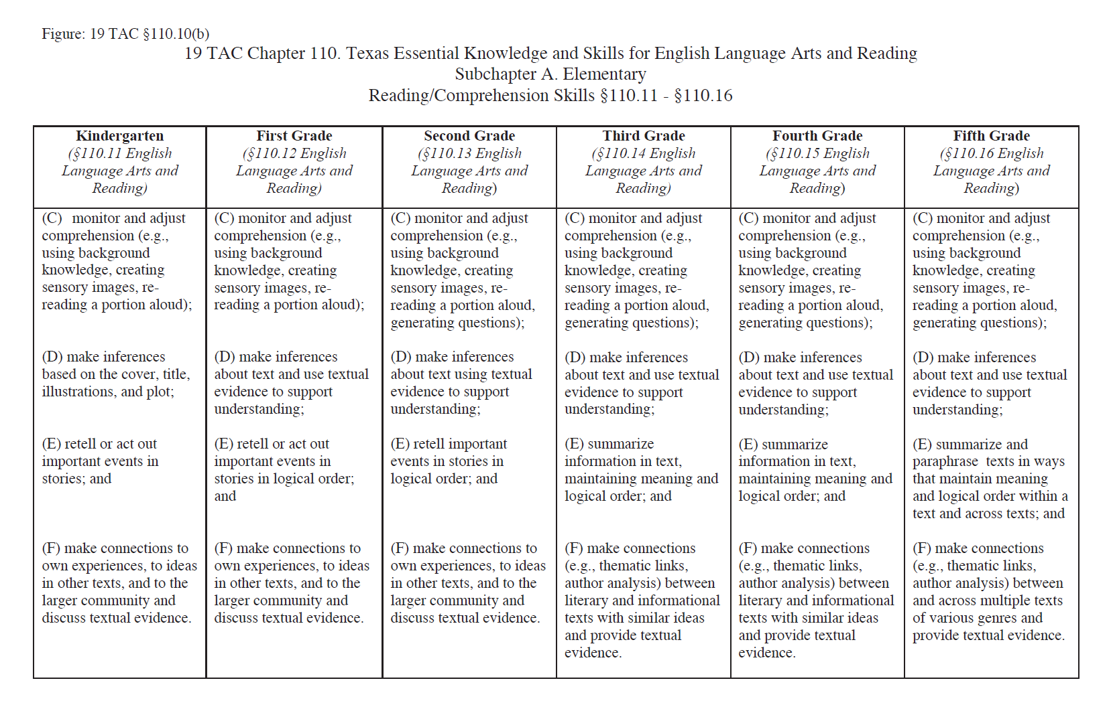
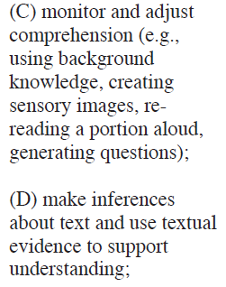
Why Should We Teach Making
Inferences and Predictions?
Fig. 19
Reading/Comprehension Skills
Students are expected to…
make complex inferences
about text and use textual evidence to support understanding.
Notes:
Say: As well, we know that inferring is identified on Figure 19 of the TEKS. For example, fourth grade students are expected to “make inferences about text and use textual evidence to support understanding.

Slide 14
MAKING INFERENCES and PREDICTIONS?
How Should We Teach
Notes:
Say: How should we teach making inferences and predictions? Today we want to think about ways to make our instruction more effective.

Slide 15

“In fourth grade, I asked my teacher to show me how she figured out a difficult ending. She smiled and said, “Cris, you need to read between the lines.” I skipped happily back to my seat, thinking I had been given privileged information. I opened my book only to find to my disappointment that between the lines was just white space.”
(Tovani, 2000, p. 98)
Notes:
Say: Before we begin, let’s look at one student’s experience with learning to make inferences. As I read, I want you to think about what the problem is.
Read slide.
Say: What’s the problem here? Think (provide 10 seconds of think-time). Turn and talk to your neighbor.
Provide 1 minute for participants to discuss.
Say: Often when we teach these cognitive strategies, we are not clear about the relationships between text clues, background knowledge, and our ultimate predictions and conclusions. As author Cris Tovani says: “When teachers use phrases like read between the lines, make an inference, draw a conclusion, think harder, they are not showing students how to infer, they are merely telling them to infer” (Tovani, 2000, p. 99).
So how do we help our students with these skills?

Slide 16
The Teacher Is Key
“Children’s difficulties on inference-related items often correlate to teachers’ lack of clarity about what good inference instruction looks like… if we’re not sure how to describe inference, our instruction tends to be less explicit, less frequent,
and less than memorable.”
(Keene & Zimmermann, 2007, p. 148)
Notes:
Read slide.
Say: We use clear and explicit language when teaching cognitive strategies to our students. I talked about the Big Ideas for this training and the first idea was explicit instruction. The teacher is key! Students require explicit instruction on how to infer and predict in order to be successful. This means that as teachers, we need to understand what inferring is and how to provide instruction on inferring.

Slide 17
How Should We Teach Making
Inferences and Predictions?
When children are explicitly taught inferential skills, “the enjoyment of the task of reading is enhanced and is, therefore, more likely to be undertaken readily, even by pupils who may have initially found reading difficult.”
(McGee & Johnson, 2003, p. 49)
Notes:
Say: Here is another important reason for explicitly teaching students to make inferences and predictions.
Read slide.

Slide 18
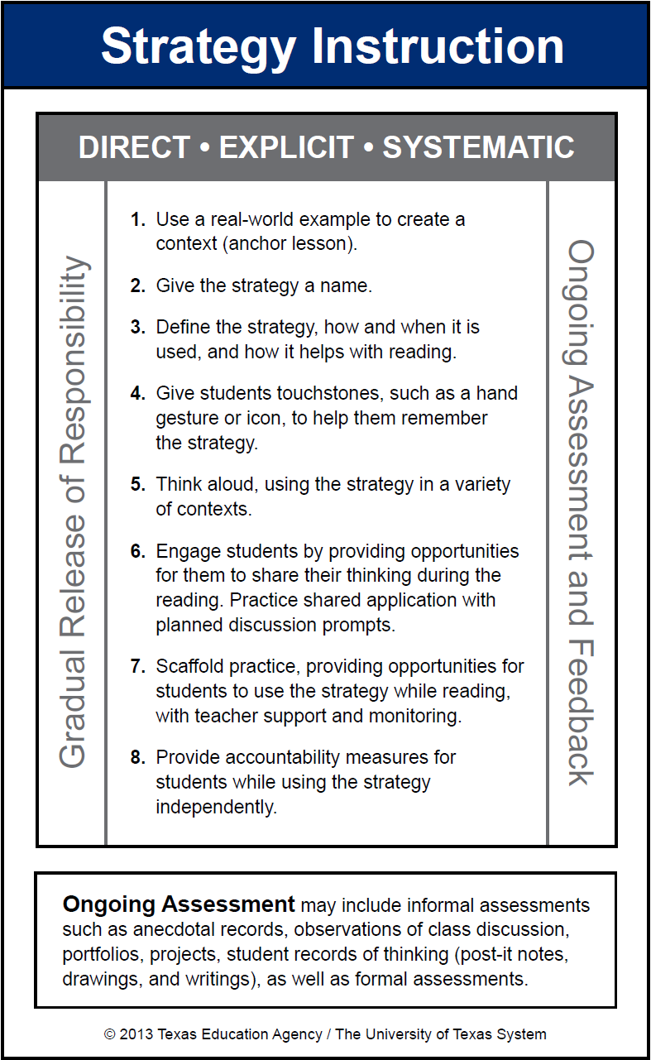
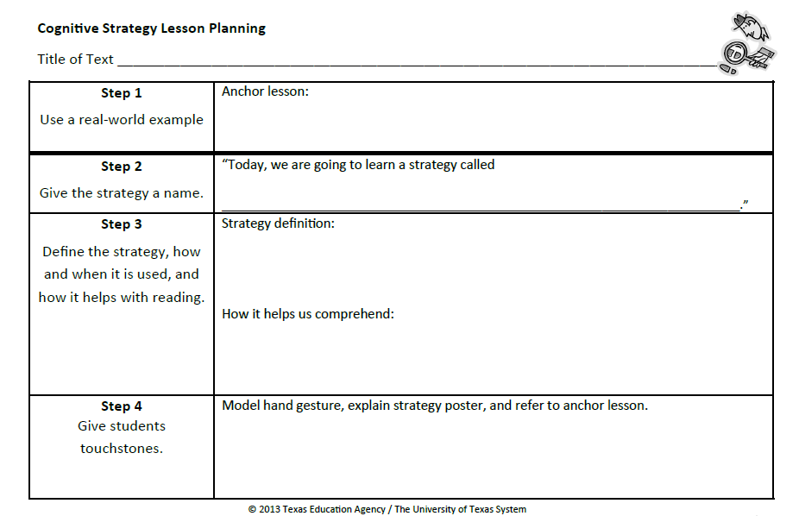
Cognitive Strategy Routine
Notes:
Say: As with all of our cognitive strategies, we want to teach making inferences and predictions to our students in a direct, explicit, and systematic manner. We use our 8-step Cognitive Strategy Routine.
This routine is important because it scaffolds the learning for our students by keeping our instruction consistent. Please take out your blue and white Cognitive Strategy Routine Card so that you can follow along as I model the steps. You can also take out your Making Inferences and Predictions Lesson Planning Card because we will be using that shortly as well.

Slide 19

Use a Real-World Example (Step 1)
An anchor lesson is a real-world example used to create context for a cognitive strategy.
It is useful to create a different anchor lesson for each cognitive strategy.
We refer to the anchor lesson to remind students of the cognitive strategy.
Learning is more consistent for students when the same anchor lesson is used within and across grade levels.
Notes:
Say: We begin all strategy instruction the same way – with Step 1, using a real-world example to create a context for the strategy. This step is important because cognitive strategies are just that – cognitive. That means that they happen in our heads, which makes it hard to see what we are talking about. For many of our students, these cognitive strategies are abstract concepts. A real-world example helps students to realize what the strategy is, and that they already use it in their everyday lives. It is important that we know our students well and are familiar with their backgrounds and interests so we can choose examples that will have meaning to them.
We call this part of the routine an anchor lesson. We will refer to this lesson every time that we teach making inferences and predictions. This lesson will be the “anchor” that immediately reminds students of a time when they were aware of the inferences and predictions they were making.
Read slide.
Let’s take a look at a possible anchor lesson for making inferences and predictions. Our primary focus today will be on how to teach students to make inferences. Keep in mind, that predictions are a type of inference.

Slide 20

Anchor Lesson for
Making Inferences & Predictions
Notes:
Bring in a sample backpack with several items inside (see below for suggestions). Take one item out at a time. Show the “clue”. Think aloud or ask participants to infer something about the owner of the backpack from the clue. Follow up with the question, “What makes you think that?” to show how they use their background knowledge (BGK) together with the clues to make an inference.
Sample Think-aloud:
Say: Boys and girls, I have a backpack here. I don’t know to whom it belongs. There is no name on it. Let’s be detectives and use our background knowledge and the clues inside the backpack to help us figure out to whom it belongs.
I notice that it has pink flowers on it. Let’s see what’s inside. (Pull out a tube of lip gloss). Lip gloss. It’s cherry flavor.
This backpack is similar to my daughter’s backpack. She also likes to wear lip gloss. This is information that’s in my background knowledge—my experience. I know that girls often have flowers on their backpacks and that they like to use lip gloss. Not many boys carry lip gloss in their backpacks. These clues, plus my background knowledge help me to infer that this backpack likely belongs to a girl. Would you all agree with my inference?
Continue in this manner. Pulling each clue out, one at a time. Identify the clue, share your background knowledge and the inference that you make or ask participants to share their thinking.
Clue: hair brush + a hair scrunchie
BGK: I know that many of you with long hair have brushes and scrunchies in your backpacks.
Inference: I’m inferring that the backpack belongs to someone who has long hair.
Clue: chapter book
BGK: When I flip through this book, I can see that the print is small and there are 250 pages in it. This looks like a book that a fourth or fifth grader might read.
Inference: Based on all of the evidence, I predict that the backpack belongs to an older female student.
Say: We were able to make some good inferences and an overall prediction about the person who owns this backpack. Just like a detective, we looked at the clues and used our background knowledge to figure out some things.

Slide 21
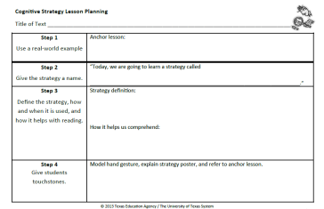
Use a Real-World Example (Step 1)
“Remember when we looked through the backpack and used the clues in the backpack and our background knowledge to figure out who owned the backpack?”
Record what you will say for Step 1 on your orange Cognitive Strategy Routine Lesson Planning Card.
Notes:
Say: Now it is your turn to think about Step 1. You may choose to introduce Making Inferences and Predictions to students by using a lost backpack. If you choose to use another anchor lesson to introduce Making Inferences and Predictions, be sure to think about your students’ background knowledge. Whatever you choose to do should be familiar, or something to which your students will be able to relate.
Take a moment to discuss with the colleagues at your table what you think you will say for your Step 1. Record what you will say on the orange Lesson Planning Card. You have a Vis-à-vis and a Sharpie in your supply pouch that you can use to write with.
Allow time for participants to complete.

Slide 22
Teaching the Strategy (Steps 2-4)
Notes:
Say: An anchor lesson is our introduction to the strategy. Steps 2-7 are how we teach the strategy. What we plan to say and do for the next 3 steps will be repeated EVERY time we teach this strategy. In other words, we do these 3 steps before every think-aloud and every shared practice opportunity.

Slide 23

Give the Strategy a Name (Step 2)
“Today, we’re going to talk about a strategy called Making Inferences.”
Record what you will say for Step 2 on your orange Cognitive Strategy Routine Lesson Planning Card.
Notes:
Say: Step 2 is, “Give the strategy a name.” We want to use clear and consistent language when referring to the cognitive strategies. Our comprehension strategy instruction is stronger if everyone in the district uses the same vocabulary to refer to the strategies we are teaching.
Read red text and the bottom part of the slide.
Allow time for participants to complete.

Slide 24
Define the Strategy (Step 3)
“An inference is when we combine our background knowledge along with the information in the text to understand what the author is not directly telling us. Inferring helps us understand text more fully.”
Notes:
Say: Step 3 is where we define the strategy and explain how and when it is used and how it helps with reading. For example, we might say …
Read slide.

Slide 25
Teaching the Strategy (Step 3)
“Today, I want to show you how I infer. I’m going to pause as I read and I’ll share my inferences.
Inferences are really important and great readers make them all the time. An inference is something a reader knows from reading, but the author doesn’t include it in the book. It helps you understand the story more deeply and helps make books mean something very personal to you.”
(Keene & Zimmermann, 2007, p. 148)
Notes:
Say: Here is another example of Step 3.
Read slide.

Slide 26
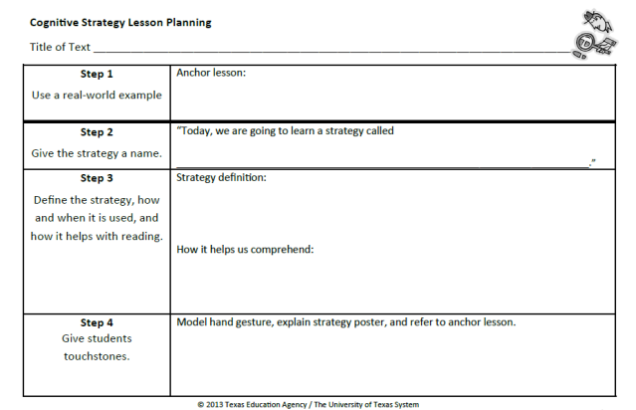

Define the Strategy (Step 3)
Record what you will say for Step 3 on your orange Cognitive Strategy Routine Lesson Planning Card.
An inference is…
Notes:
Read slide.
Allow time for participants to complete.

Slide 27

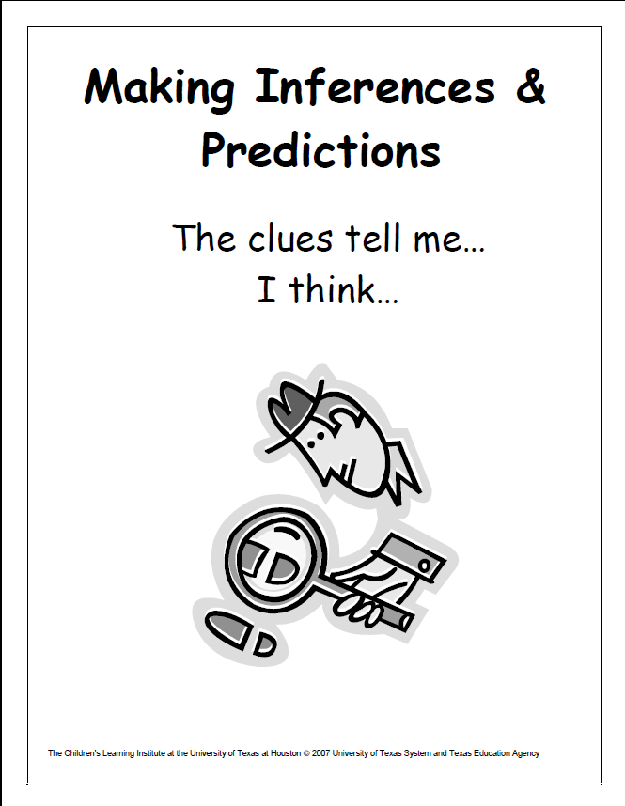
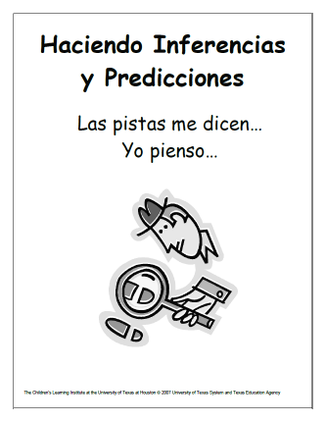

Give Students Touchstones (Step 4)
Provide students with a hand motion that signals “Making Inferences and Predictions.”
Display strategy posters in the classroom.
Notes:
Say: To make the strategy more explicit for our students, we give them touchstones that will help them remember and understand a strategy.
These touchstones include a hand motion and a poster with a visual icon with words for support. I might place a reminder of the anchor lesson on the poster. The hand signal for making inferences and predictions is two fingers together pointed downward to the text. This shows that a connection is made between the reader’s background knowledge and clues from the text.
I want my students to value these touchstones, so I explicitly explain to them what the hand signal and poster represent.
For example, I might say something like this …
Click to next slide.

Slide 28
Give Students Touchstones (Step 4)
Touchstones: Model the hand gesture, explain the strategy poster and refer to the anchor lesson.
“When I make an inference, I will show you by doing this hand signal. My two fingers come together to show I am using my background knowledge. My fingers point down toward the text to indicate I am combining my background knowledge with evidence in the text to make an inference. Look at the detective on our poster. He is searching for clues in the text and using his background knowledge to make an inference. We made inferences when we tried to figure out to whom the backpack belonged.”
Notes:
Read the red text on the slide.

Slide 29
Give Students Touchstones (Step 4)
Record what you will say for Step 4 on your orange Cognitive Strategy Routine Lesson Planning Card.
Notes:
Say: Work with others at your table. How will you explain the touchstones to your students?
Read slide.
Allow time for participants to complete.

Slide 30
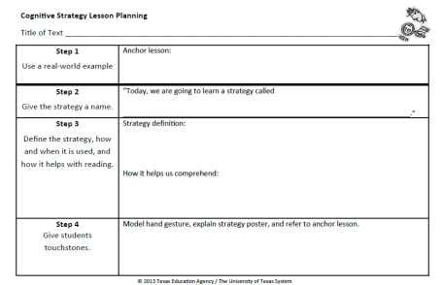

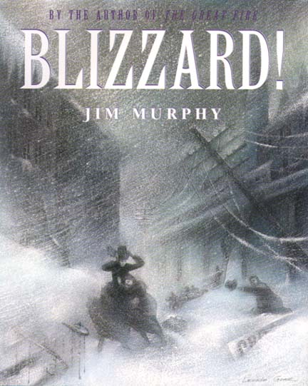
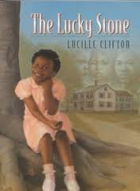

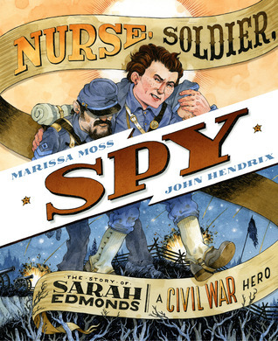
Steps 2-4
Every time we teach a lesson focusing on the Making Inferences strategy, we will repeat Steps 2-4. We will do this many times across several days with different reading selections.
Notes:
Read slide.
Say: I have a different orange Lesson Planning Card with Steps 2-4 completed for each of the different cognitive strategies that I teach.

Slide 31
Think-Aloud (Step 5)
“A think-aloud is a way to provide instruction rather than just give instructions” (Daniels & Zemelman, 2004, p. 238).
Students who struggle with reading “in general do not possess knowledge of strategies and often are not aware of when and how to apply the knowledge they do possess” (Duffy et al., 1987, p. 348).
Notes:
Say: Now that we’ve introduced the strategy, how do we begin to teach students how to make inferences?
Step 5 of the Cognitive Strategy Routine is where the teacher models for students using the strategy through a think-aloud. A think-aloud is a way to provide instruction rather than just give instructions (Daniels & Zemelman, 2004, p. 238).
During a think-aloud, teachers explicitly show students how and when the strategy is used in a variety of contexts. This really is the critical piece of our instruction; and yet, it is the one step that often gets left behind. Research tells us just how important this step is. For example …
Read slide.

Slide 32
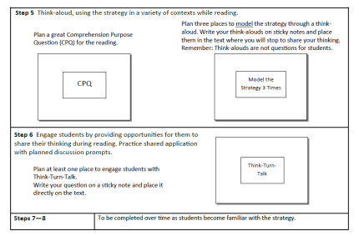
Cognitive Strategy Lesson Planning Card (Side 2)
Step 5 is where we SHOW students how we use the strategy while reading.
We plan a Comprehension Purpose Question (CPQ), as well as places to model thinking-aloud for students.
Step 5 will differ with each lesson.
We transfer the sticky notes from the planning card and place them on our teacher edition or text.
Notes:
Read slide.

Slide 33


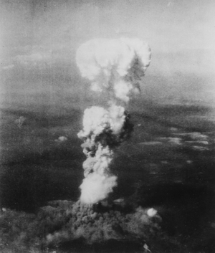
Think-Aloud (Step 5)
Notes:
Say: I’m going to model for you how I would explicitly think aloud for students how I am aware of the inferences I make. I’m going to use an excerpt from this text, Sadako and the Thousand Paper Cranes by Eleanor Coerr. You have a copy of this in your Text Excerpt packet.
This is a true story about a girl who lived in Hiroshima on the day that the United States dropped the atomic bomb in an attempt to end World War II. Ten years later, Sadako becomes ill with leukemia, the "atom bomb disease”. There is a Japanese legend that says that if a sick person folds 1,000 paper cranes, the gods will make her well again. Sadako spent long hours in bed, folding those paper cranes, never giving up that hope. Since my students would likely not have a lot of background knowledge about this topic, I would need to spend time building background knowledge prior to teaching lessons using this text. We won’t take time to model building background knowledge for you today, but let’s not forget that this is a critical step in helping our students to successfully comprehend text about an unfamiliar topic.

Slide 34
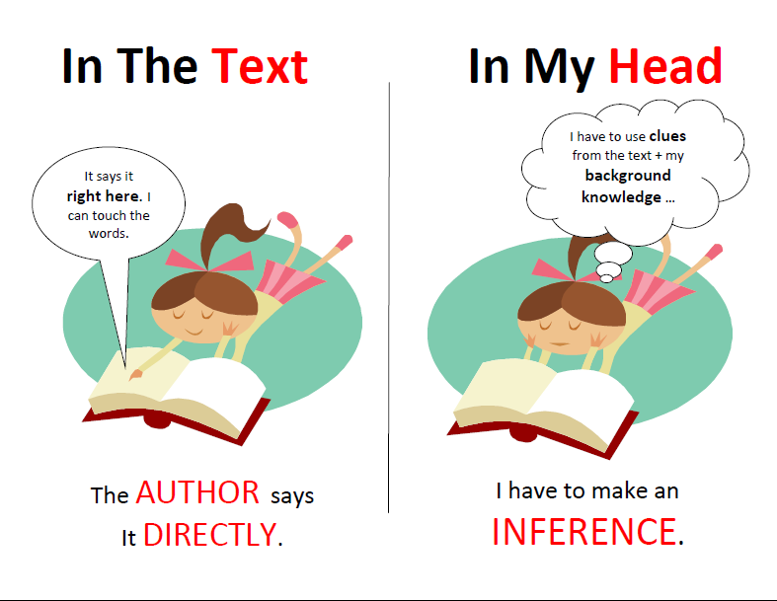
Think-Aloud (Step 5)
Use scaffolds to support student learning.
Sadako is excited about Peace Day.
Notes:
Say: To further support students in their awareness of the inferences they make, we will also use this supporting poster during the lesson. It’s another visual way to help students understand what an inference is. The poster helps students clearly understand what we mean when we say that some information is directly told to the reader versus when a reader must make an inference. We use the terms direct and inference which is another way of saying explicit and implicit. You each have a copy of this supporting poster.

Slide 35
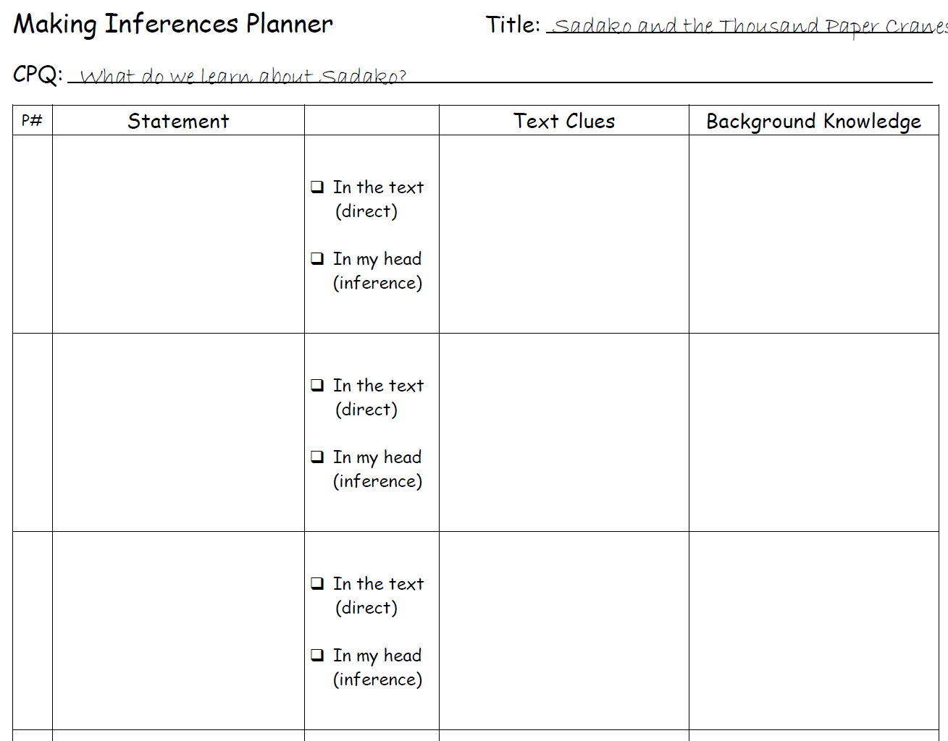
Think-Aloud (Step 5)
Sadako was born to be a runner.
x
“Get up lazybones! It’s Peace Day!”
Exclamation marks.
Says she can hardly wait for the carnival.
When someone runs out of the house, they are usually excited to get somewhere.
Authors use exclamation marks to show the reader something is exciting.
Sadako is excited about Peace Day.
x
Sadako is eleven years old.
x
Sadako is excited about Peace Day.
Notes:
Say: Let me model for you now, a think-aloud lesson for Sadako and the Thousand Paper Cranes.
SAMPLE SCRIPT:
Today we are going to begin reading the novel I’ve been telling you about. Remember, it’s called Sadako and the Thousand Paper Cranes. I read the Prologue to you yesterday when we talked more about Hiroshima and the atom bomb.
Today we are going to begin with Chapter 1. As we read, we are going to learn more about making inferences. When you make an inference, you use clues from the text and your background knowledge. When you make inferences, you have a better understanding of what is happening in the story. I’m going to show you how good readers make inferences when they are reading.
The CPQ for Chapter 1 is: What do you learn about Sakado? We are going to learn a lot about Sadako in Chapter 1. Some of the things we learn will be told to us directly and some of the things we learn we will have to infer. If we can touch the words and they are right there in the text, then the author told us the information directly. (Point to Supporting Poster). That would NOT be an inference. But, if the author doesn’t tell us directly and the information is not right there, I can’t touch the words … then we used clues from the text along with our background knowledge to make an inference. (Point to Supporting Poster).
Let me show you what I mean.
Begin reading Chapter 1 aloud. Stop at the bottom of page 10 (Can we please hurry with breakfast?).
I think that we have already learned some things about Sadako on these pages. I learned that Sadako was born to be a runner. (Show sentence strip.) I know this because the author told me this directly. It says so, right in the first sentence on page 9. I can touch the words. I am not making an inference. (Place sentence strip in the middle of the pocket chart under heading that says direct.)
I also learned that Sakako is excited about Peace Day. Hmmm. I know that is true but I can’t seem to find those words in the text. There are some clues that help me to know this about Sadako. It says, “Get up lazybones! … It’s Peace Day!” I know from my background knowledge that when you are excited about something special, you want everyone to get up and get going. I also see lots of exclamation marks. That indicates excitement. She also tells her mother that she can hardly wait for the carnival. When you can hardly wait for something, that’s usually because you are excited. All of the clues in the text plus my background knowledge help me to make the inference that Sadako is excited for Peace day.
Let’ keep reading and see what else we learn about Sakado.
Continue reading. Stop at the bottom of page 11 (… while Mr. Sasaki spoke.)
Ok, so now we’ve learned a bit more about Sadako. I learned that she is eleven years old. (Show sentence strip.) I know this because the author told me this directly. It says so, right at the top of page 11. I can touch the words. I am not making an inference. (Place sentence strip in the middle of the pocket chart under heading that says direct.)
I also learned that Sadako’s family says prayers together every morning. Hmmm. I know that is true but I can’t seem to find those words in the text. There are some clues that help me to know this about Sadako. It says, “As a matter of fact it’s time for our payers now.” I know from my background knowledge that when there is a time for something, it usually means you do that every day. It also says that they gathered around the little altar. An altar is a special place in set up for prayer. They must pray often if they have a special place to do it in their house. All of the clues in the text plus my background knowledge help me to make the inference that Sadako and her family pray every day.
Say: This is what a think aloud for making inferences might look and sound like. Turn and talk with your partner about what you noticed during the lesson and how you think the sentence strips and the Making Inference Support poster might help your students.
Allow time for a brief discussion. Share out.

Slide 36
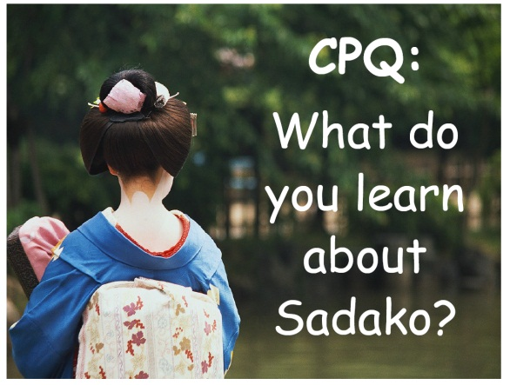
Think-Aloud (Step 5)
Sadako was born to be a runner.
x
“Get up lazybones!” “It’s Peace Day!”
Exclamation marks
Says she can hardly wait for the carnival.
When someone runs out of the house, they are usually excited to get somewhere.
Authors use exclamation marks to show the reader something is exciting.
Sadako is excited about Peace Day.
x
Sadako is eleven years old..
x
Notes:
Say: As we plan our daily lessons, we will use our orange planning card. For each lesson or chunk of text we will read with students, we will need to set a CPQ. We will also use the think-aloud sticky notes and place them in our book to remind us when to stop and what we are going to say. To further assist us in our planning, we are going to use a middle step. I will show you how to use the Making Inferences Planner.
This planner is designed to help us ensure that our instruction is explicit. It will also help us plan to implement a scaffold to help students to clearly understand when they are making inferences and when they are not.

Slide 37
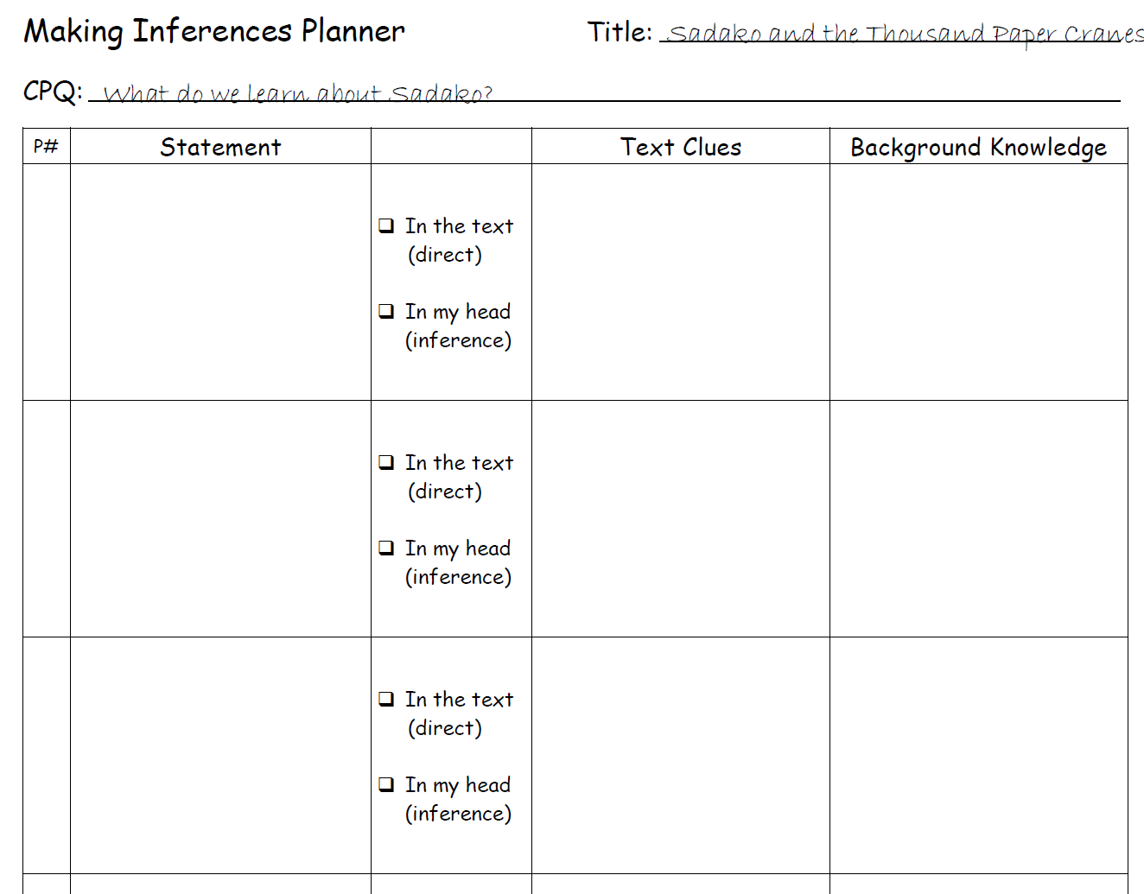
Handout
2
Sadako was born to be a runner.
x
“Get up lazybones! It’s Peace Day!”
Exclamation marks.
Says she can hardly wait for the carnival.
When you are excited about something special, you want everyone to get up and get going.
Authors use exclamation marks to show the reader something is exciting.
When you can hardly wait, you are excited.
Sadako is excited about Peace Day.
x
Sadako Is eleven years old.
x
Notes:
Say: The teacher uses the Making Inferences Planner to plan statements derived from the text that answer the CPQ. These statements should be written on sentence strips prior to the start of the lesson. During reading, the teacher will stop periodically and share the statements with students. The teacher will first model, thinking aloud whether or not the statement is directly stated in the text or if the statement is an inference. If the statement is an inference, then the teacher would need to explain the text clues as well as the background knowledge she relied on to make the inference.
This type of activity helps students to actively think about the text while they are reading because it helps them to “explore a text by using text-explicit and text-implicit thinking processes…. It is a child-centered strategy that allows the teacher to guide children both to the ideas in the text and to the processes involved in getting those ideas” (Searfoss & Readence, 1994, pp. 246-248).
You have a copy of the completed planner for first lesson for Sakako and the Thousand Paper Cranes in your Additional Handout packet. It is Handout 2.

Slide 38
Think-Aloud Practice
When thinking-aloud, use language like…
I learned ________. I know this because the author told me
directly. It says so, right here on page ___. I can touch the
words. I am not making an inference.
I also learned _______. I know that is true, but I can’t seem
to find those words in the text. There are some clues in the
text that help me to know this. It says, ________ on page ___.
From my background knowledge, I know _________. The
clues in the text plus my background knowledge helped me to
make an inference.
Notes:
Say: Now let’s take some time to practice. You won’t have sentence strips to put in a pocket chart as you think aloud, but you should be able to read a bit of the text and then stop to think aloud, explaining your statements to your partner.
Read slide.
Provide time for participants to practice their think-aloud with a partner.
Say: we have spent a fair bit of time on Step 5, the think-aloud step. We spent so much time on this step because it is an important step that is often left out of our instruction.
Now let’s look at the remaining steps in the Cognitive Strategy Routine.

Slide 39
Engage Students (Step 6)
Ask students to share their thinking. Show them statements on the sentence strips and ask them to identify whether or not the statement is directly stated in the text or if they have to make an inference.
Is this true? Did the author tell us this directly or are we making an inference?
Sadako is very helpful.
Notes:
Say: Let’s review our blue and white Cognitive Strategy Routine card. What does it say for step 6?
Read step 6 from the card.
Say: Let’s focus on two ways we can engage students in our lessons. One way will use this sentence strip scaffold, and the other way will use our Think-Turn-Talk routine. Let’s discuss the sentence strip scaffold method first.
If we are using the sentence strip scaffold, then we can ask students to share their thinking with the class.
Read slide.

Slide 40


Engage Students (Step 6)
Ask Think-Turn-Talk questions that require students to make inferences.
    “Think about the inference(s) you
    need to make to answer this question:
    – Why did Shade…?”
    – How did Shade feel…?”
    – Why does his mom…?”
    – What are the owls…?”
Notes:
Say: For example, when reading Silverwing, I might stop at a key part of the story and ask a question. For instance, I might say, “Think about the inferences you need to make in order to answer this question. Why did Shade break the rules and stay out to see the sun?”

Slide 41
Scaffold Practice (Step 7)
In the text.
The author says it directly.
In my head.
I have to make an inference.
Answer to the CPQ
Answer to the CPQ
Answer to the CPQ
Answer to the CPQ
Answer to the CPQ
Answer to the CPQ
Notes:
Say: As students become more proficient with the strategy, we gradually release responsibility. For Step 7 of the Cognitive Strategy Routine, we provide opportunities for students to use the strategy while reading with teacher support and modeling. For example, we might assign a chunk of text to students to read and provide them with a CPQ for that chunk. We can ask students to flag the text when they find the answers to the CPQ. When the students are finished reading we can work together as a small group to categorize their answers to the CPQ. Is the answer told to them directly by the author, or did they have to make an inference?

Slide 42
Provide Accountability Measures (Step 8)
Complete a T-chart with your answers to the CPQ.
In your Reading Reflection Journal, record an entry explaining the inferences you made while reading today.
Notes:
Say: By Step 8 of the Cognitive Strategy Routine, students should be more aware of the inferences they make while reading. As they read independently, we can ask them to share their thinking with us in numerous ways. Our goal, is to find ways for us to see if students are successfully using the strategy independently. If not, then we may need to provide more support to those students who need it.

Slide 43
ACROSS CONTENT AREAS
Making Inferences and Predictions
Notes:
Say: We’ve spent a lot of time focused on how to teach making inferences with narrative text. We haven’t talked much about predicting or how we might teach inferring with informational text. Let’s take some time to do that now.

Slide 44
Making Inferences and Predictions in Science
Model language during simple observations:
  “The little girl is yawning and rubbing her eyes. I can infer she is sleepy. I predict she will go to bed soon.”
Model language during scientific observations:
  “The hen’s eggs are beginning to shake. I can infer the chicks are ready to hatch. I predict the shells will begin to crack next.”
Notes:
Say: Observations provide excellent opportunities for making inferences and predictions. This can begin with very simple observations that may not be related to the science curriculum.
Read the first bullet and sub-bullet
Say: We can quickly transfer this to science.
Read the final bullet and sub-bullet.
Say: Let’s think about how this might look with actual science text.

Slide 45
Big Ideas
Importance of explicit instruction.
Scaffold for success.
Across content areas.
Notes:
Say: Let’s revisit the “Big Ideas” we hope you will take away from this training.
The first Big Idea was the “Importance of explicit instruction.” These are complex skills that require explicit instruction in order for students to be successful. Explicit instruction that begins with an anchor lesson and strategy instruction that follows a clear routine will set students up for success.
The second Big Idea was “Scaffold for success.” We want to provide supports to enable our students to be successful and gradually fade those scaffolds. Providing students with an organized way to record their thoughts and help to look for and analyze inferences is important. These scaffold can be gradually faded over time.
The last Big Idea was teaching making inferences and predictions “Across Content Areas.” We see that these are not just thinking processes we expect students to use in ELA. Instead, these are the thinking processes we want to teach our students in every subject area for many years.

