Slide 1
Developing Vocabulary Using a Letter Wall
Prekindergarten
Notes:
Set up notes:
Check room for best location for the letter wall.
Attach letter wall background and letters.
Make sure all participants have signed in and received agenda/handouts and letter cards.
Determine if any materials need to be distributed to tables. For example, supply boxes and sentence strips
Equity sticks (slide #13)
Put out one pink and one blue direction card on each table (slide #18)
Set up presenter’s table with letter wall materials
Set up a supply table with materials for letter wall activities (slide #26)

Slide 2
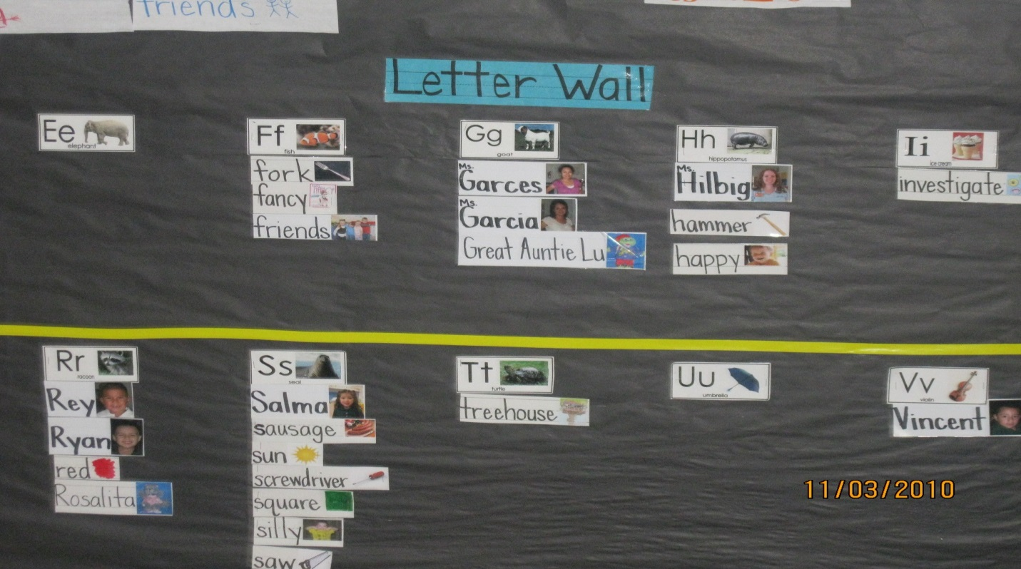
Developing Vocabulary Using a Letter Wall
Notes:
Say: Welcome to this session – Developing Vocabulary Using a Letter Wall.
Follow by introducing trainer(s), including a short bit of information about each trainer. Give a very short overview or synopsis of the training.
Say: Let’s see who is here today. As I call off the name of a group, if it refers to you, please raise your hand. Are there any Pre K four teachers? Any teachers who work with three year olds? Any coaches or site leaders? Is there anyone I left out? I am so glad you are here today with us and looking forward to a great conversation about Pre K children and the use of a letter wall.
Let’s consider our ground rules for today: Take care of your needs when necessary
Silence electronic “distractors”
Be respectful to each other and the presenters
Participate and make a new friend
Have fun!
Activity: Making Name Tents
Say: Everyone will make a name tent with first names written boldly (as per model that you show). Choose a colored paper from the table and fold it in half. (model) After it is folded, write your first name so that the presenter can easily read it. (model)
On the lower right corner write a scientific word that relates to space exploration and that is not a noun.

Slide 3
Goals for This Training
During this session, we will:
Demonstrate the construction of a letter wall.
Provide a plan for building the letter wall over the school year.
Identify strategies for using the letter wall to build letter knowledge and rich vocabulary.
Build a robust letter wall.
Notes:
Say: During this session we will focus on the construction and use of the letter wall. Let’s review the goals.
Read slide.
Say: You can find additional information about the letter wall in the Texas Prekindergarten Guidelines on pages 74 and 75.
Discuss background information, including:
– Define and discuss a letter wall.
– Consider the benefits and challenges.
– Talk about the placement of the letter wall.
Consider a plan for implementation, including:
– Plan for the beginning of the school year.
– Plan for the following months.
Work together to create a robust letter wall.
Engage in letter wall activities.

Slide 4
Background Information
What is a letter wall?
What are some of the benefits and challenges of creating and using a letter wall?
What should you consider about placement and size of a letter wall?
Notes:
Say: During the next few slides, we will consider these questions.
Read slide.

Slide 5
Definition of a Letter Wall
A letter wall is a visual tool that can be used
by preschool children to help them learn the
characteristics, names, and sequence of the
alphabet.
It helps the children understand how letters go together to form words.
It is constructed at eye level for children to do hands-on activities.
Notes:
Read slide.
Say: Using a letter wall helps support the Pre K guidelines and is an appropriate and fun way to teach letters and words. In the upper grades, you might see a similarly looking visual aid called a word wall. On a word wall, the emphasis is on the vocabulary words rather than the letters that form the words.
Activity: Sharing Letter Wall Experiences
Say: Talk at your tables about your experiences with letter walls including the challenges and benefits of using a letter wall in your Pre K classrooms.
Allow two minutes for table teams to discuss. Do not share out as we will discuss during next two slides.
Say: Let’s look at a few slides as we consider the benefits and challenges of using a letter wall.

Slide 6
Letter Wall Benefits
A letter wall is a:
Great visual tool.
Highly effective means of engaging children with letters.
A letter wall supports learning by addressing:
Letter characteristics, names, and sounds.
Vocabulary across all content areas.
Concepts of print.
Notes:
Read slide.
Say: Did your teams consider any of these benefits?
Allow a minute of sharing.

Slide 7
Letter Wall Challenges
Where do I place it?
How much space is required?
What does it look like?
What materials do I need?
How do I use it? How do children use it?
When do I use it? When do children use it?
What objectives does it support?
Notes:
Read slide.
Say: Did any of you share these challenges when you were talking at your table? What were some of them?
As I have worked with teachers and leaders, these questions have come up for discussion. During this session, we will problem solve and answer these questions.
Allow a minute or two to share challenges that the participants have experienced.

Slide 8
Placement and Size
Consider the location:
Space should be accessible to children.
Space should be available during whole group time.
Two rows work well.
Allow space for at least five to seven words.
A clear topper for letters and pictures is required.
Ideal spacing is nine inches between each letter.
Notes:
Read each bullet and add detail below.
Bullet one: A letter wall is supposed to be interactive. Where you place it matters. If you want children to be able to touch the letters and words and play “games” with the letter wall, it has to be available to them.
Bullet two: Having your letter wall in your large group circle area is a great idea. That way you will be more likely to use it every day.
Bullet three: When a letter wall has several rows, it starts to look like a patchwork quilt. Having one or two rows is a better plan.
Bullet four: As you use the letter wall over the year, you will want to have plenty of space to add words. By planning ahead of time, you will be prepared to place five to seven words under many of the letters.
Bullet five: When you build your letter wall, you will use the letter cards followed by a picture to define the space. There is no need for a border.
Bullet six: When you place each letter, consider how much space you need to allow for longer words. Nine inches is a great size to use if you have the space.

Slide 9
Setting Up the Letter Wall
Let’s look at the basic frame for a letter wall.
What do you notice?
Notes:
Say: Let’s look at the basic frame of this letter wall (indicate posted letter wall) What do you notice?
Some responses might be:
It has a dark background
It has clear, easy to read toppers
It has no border
It has sufficient space between letters
It has two rows of letters

Slide 10
Introducing and Using a Letter Wall
As we view the next few slides, we will think about and plan how to:
Introduce and explain the letter wall to children as the school year begins.
Place the first words on the letter wall.
Grow the letter wall over the year.
Engage children in letter wall activities.
Notes:
Read slide.

Slide 11
The First Weeks
During the first weeks, you:
Post the letter wall frame in the whole group area.
Take time daily to explain the letter wall to the children.
Make name cards for all the children and staff who work in the room.
Talk to the children about the system for placing words on the letter wall.
Add a couple of names every day.
Review names daily until all names are posted.
Children start to refer to their names on the wall.
Notes:
Say: As you get started with your letter wall, here are some steps to follow.
Read Slide.

Slide 12
Building Your Letter Wall
Create a name tag with your picture on it.
Use white sentence strips and a black marker to write your name.
Select colors for your self-portrait.
Draw your picture close to your name.
Attach your name tag to the letter wall with blue tape.
Notes:
Say: As we work together in this session, you will be helping me build our letter wall. We will have several opportunities to add various words to our letter wall to make it a great teaching tool. Each time you will use the white sentence strips and black sharpies to write the words then illustrate them with any colors you would like.
Read Slide.
Model your completed name card. Place your name card on the letter wall under “your letter” (eg. Mine will go under the letter J for Josie). Emphasize that the first letter of each name should be directly under the matching letter. Trim excess paper if necessary, and explain that this can save space for more words over the course of the year.
Activity: Participants Make Name Cards
Say: You will have five minutes to complete this activity. In your classroom, when you do this with children, you may have photos to attach to the name cards. You might also use equity sticks to help the children learn to take turns.
Allow five minutes for participants to complete their tag. As they are working, you can share the following information.
Say: You will need to decide on a system for placing the names on the letter wall. You may staple, use magnets, or use Velcro. Whichever system for attaching you use, make sure you have the materials you will need to get the job done. You will also need to decide if you are going to print the words on sentence strips or print them on your computer. Whatever you decide, it is vital that you use the same size font or print for all the word cards all year. One of the activities you will be doing entails looking at the length of the words, so the size of the font needs to remain the same whether it is a long word or a short one. Also, decide on the color paper and ink you will use and be consistent. When you change colors your letter wall starts to look like a patchwork quilt!
Another system you will need to explain to your children is who will help put the words up on the letter wall. You may follow a sequential order by going through the alphabet, such as starting with the children whose names begin with the letter A or B. Or you may use equity sticks such as these (show example from trainers table). Children need to know right from the beginning that everyone will have a turn to help with the letter wall.

Slide 13
The First Month
Children and staff names are on the letter wall.
Regular visitors have their names on the letter wall.
Children “touch” and refer to the letter wall daily.
Games are played using the letter wall.
Classroom items are added to the letter wall, such as the word “marker,” “scissors” or “book.”
Notes:
Read slide.
Say: You have had a month to get the children used to using the letter wall every day. They know your system, expectations, and procedures. You are referring to the letter wall daily and have started to play games with the letter wall. Perhaps the children are using the letter wall as they “write the room” or make entries in their journals.

Slide 14
Adding to Your Letter Wall
Each table team will discuss and decide on one typical prekindergarten classroom item or material.
A table team member will write the word on a sentence strip with a black marker and illustrate it.
Attach the word to the letter wall with blue tape.
You have 3 minutes for this activity.
Notes:
Say: We are ready to add some more words to our letter wall.
Please read the slide and follow the directions.
Remind participants to trim card and place carefully under the matching letter. Support participants as they add words to the letter wall.
Say: Wow! Look at how we are growing our letter wall! We now have our names, and some of the important items that might be in our classrooms.

Slide 15
Moving Through the Year
The letter wall features names and classroom objects children know and use.
Thematic words based on your units of study are added weekly.
As you read books with strong characters or settings, those names and places are added to the letter wall to build literacy connections.
Notes:
Read slide.
Say: As you add words, please remember to include interesting and rare words as well as the more standard vocabulary words. Children need a nice array of words, from the nickel and dime words such as cat, to the fifty cent words such as panther, to the silver dollar words such as saber tooth tiger.

Slide 16
Sample of a Robust Letter Wall
Notes:
Say: This is a sample of a robust letter wall that follows the guidelines we discussed.

Slide 17
More Words for the Letter Wall
Divide your table into two teams.
Each team will take a pink or blue card from the middle of the table.
With your team, follow the directions as you create a word to add to the letter wall.
When your word is written and illustrated, add it to the letter wall.
Notes:
Read slide.
Note: This activity requires the participants to write either a thematic word or a word associated with a children’s book. The direction cards have the needed information. Emphasize careful placement of the words under the matching letter.

Slide 18
Include Math Vocabulary
Your letter wall has grown from daily use!
It is now time to add math words from the domain you are studying, or activities and events that occur in your classroom.
Notes:
Read slide.

Slide 19
Include Science Vocabulary
Science vocabulary words are often overlooked for the letter wall.
Consider what topics you are studying in science.
Select words to enhance your letter wall with rich scientific vocabulary.
Notes:
Read slide.

Slide 20
Include Social-Emotional Vocabulary
As we work with young children, we need to help them learn about feelings and behaviors.
Adding “feeling” words and other social-emotional vocabulary words will enrich your letter wall.
Notes:
Read slide.
Say: It is important for children to be able to identify their feelings with words such as “disappointed” or “frustrated.” We need to be intentional in helping children understand their feelings and use the accurate words associated with that feeling.
For example, a child may say they are “mad” when they are actually “frustrated.” Identifying these words and adding them to the letter wall will help children build stronger vocabularies.

Slide 21
Look At It Grow!
During this activity, each table is responsible for creating one math, one science, and one social-emotional word for the letter wall.
Let’s see who can come up with the most intriguing words.
When you finish, place the words on the letter wall.
You have 10 minutes to complete this activity.
Notes:
Read slide.
Visit the tables as they are working and validate and support as needed.
After all the words have been added to the letter wall say: Look at our work! Can you imagine this letter wall in your classroom?

Slide 22
Include Various Parts of Speech
Nouns are the most frequent type of words found on a letter wall.
It is important for children to see other parts of speech on the letter wall.
Adding verbs, adverbs, and adjectives will enhance and enliven your letter wall.
Notes:
Read slide.
Activity: Add last words to letter wall!
Say: Now we will add our last words to the letter wall. At your table, decide as a team on two words that are not nouns that would be great additions to the letter wall. A team member who has not yet had a turn can write, illustrate and post the words on the letter wall. We will take five minutes for this activity.

Slide 23
Make It Fun for Children
Let’s consider how to make the letter wall a dynamic and educational device by using child-friendly materials and activities to engage children.
Notes:
Read slide.
Say: The next couple of slides contain some ideas that might help your children enjoy and use the letter wall frequently.

Slide 24
Letter Wall Activity
Notes:
Say: Children love to interact with the letter wall in activities like “write the room.”
Using a clipboard and some paper, ask the child to visit the letter wall and write some of their favorite words. This activity can be done during center time or any other free choice time during the day.

Slide 25
Engaging and Appropriate Activities
Creating a letter wall is the first step. Using it every day is the next step. Consider your objectives and select appropriate and fun activities, such as using:
Various pointers to find letters or words.
Fun sunglasses to find words.
Wikki Stix to circle letters.
Small Post-it notes to hide a letter.
Clear tape to mark letters.
Notes:
Read slide and show materials that are listed in the activities that will be on the trainer’s table.

Slide 26
More Letter Wall Activities
Other fun things to do:
Shine on a letter or word with a flashlight.
Become a “word detective” using a lens.
Play matching games with magnetic letters.
Have children cut out letters from ads and match them to letters.
Use the letter wall during small group lessons.
Notes:
Read slide and show materials that are listed in the bullets that are found on a supply or trainer’s table.
Say: Now it is your turn to have some fun planning activities for the letter wall. Use handout #1, Letter wall games.

Slide 27
Review and Reflect
Review and reflect.
What is the value of a letter wall?
What did you learn?
What will you do differently?
When will you do it?
What will be the outcome for your children?
Complete the “Bright Ideas” form.
Notes:
Read slide.
Say: Let’s look at Handout #3, which is Ideas for Implementation.
Say: Now let’s take a few minutes and complete Handout #4, Bright Ideas form. What were highlights of this session? What are some things you learned?
If participants seem “stuck”, you can give them a few ideas of what they may want to try and how to use the form to plan.
Say: Thank you so much for your participation today! I hope you will be able to use some of these ideas as you go back to work with your children.

